Slide 1
The Bill of Rights
VUS5c
Our Protections - Our Liberties

Slide 2
The major principles of the Bill of Rights of the Constitution were based on earlier Virginia statutes!

Slide 3
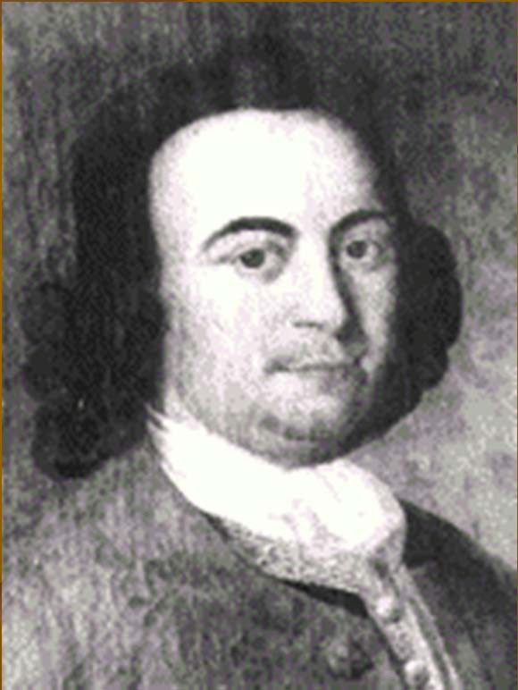
Virginia’s Influence:
The major principles of the Constitution and the Bill of Rights Came from the Virginia Declaration of Rights
This outlined basic human rights which the government should not violate.
Written by George Mason in 1776

Slide 4
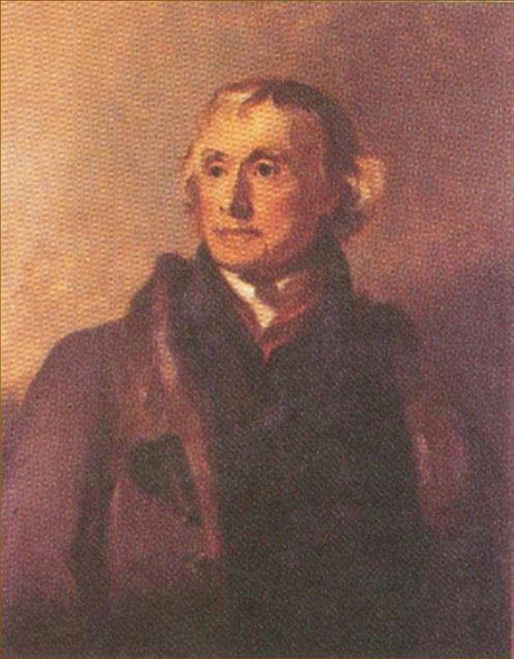
Virginia’s Influence:
The Virginia Statute for Religious Freedom ended the practice of a government supported church
Separation of Church and State in Virginia
Written by Thomas Jefferson
Separation of Church and State was very important to Jefferson

Slide 5
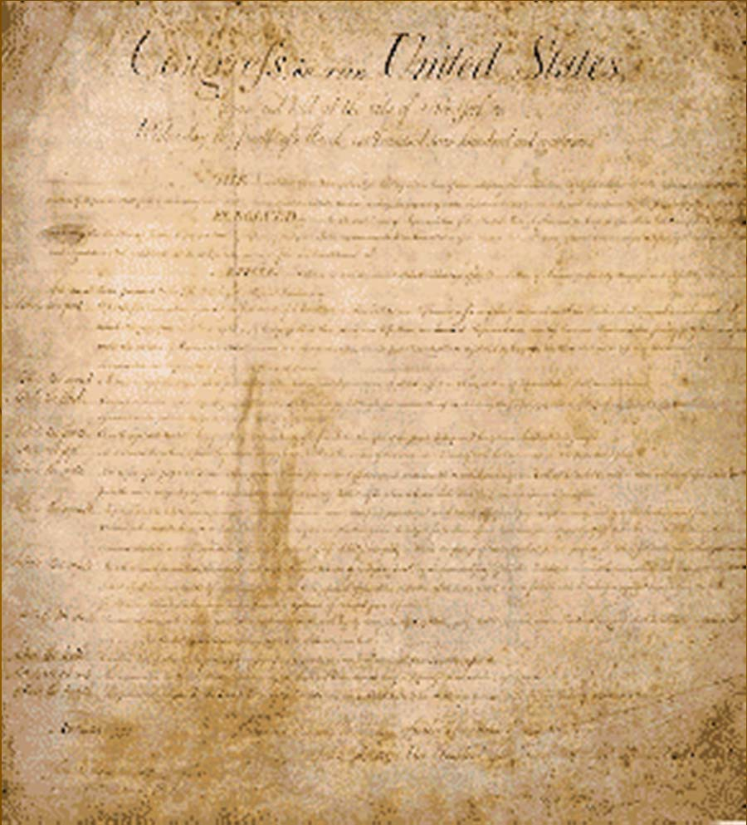
The Bill of Rights:
James Madison, a Virginian, consulted the Virginia Declaration of Rights and the Virginia Statute for Religious Freedom when drafting the amendments that eventually became the United States Bill of Rights.
The first 10 amendments to the Constitution define rights that cannot be taken away!

Slide 6
Our Essential Liberties:
1st - Freedom of religion, speech, press, assembly and petition
2nd - state militia - bare arms
3rd - quartering soldiers
4th - protections from unlawful searches and seizures
5th - grand jury indictment, double-jeopardy, self- incrimination and due process
6th - speedy and public trial, jury trial, legal counsel and confront witnesses
7th - jury trial in civil cases
8th - cruel and unusual punishment
9th - enumeration of rights
10th - Federalism (powers not delegated to U.S. or denied to states belong to states or the people)

Slide 7
The Constitution and the Bill of Rights are the rules that the government must follow.
This framework limits the power of the government- and effectively protects the liberties of the people!

