Slide 1
VUS.7c
The Civil War
The Emancipation Proclamation and the principles outlined in Lincoln’s Gettysburg Address

Slide 2
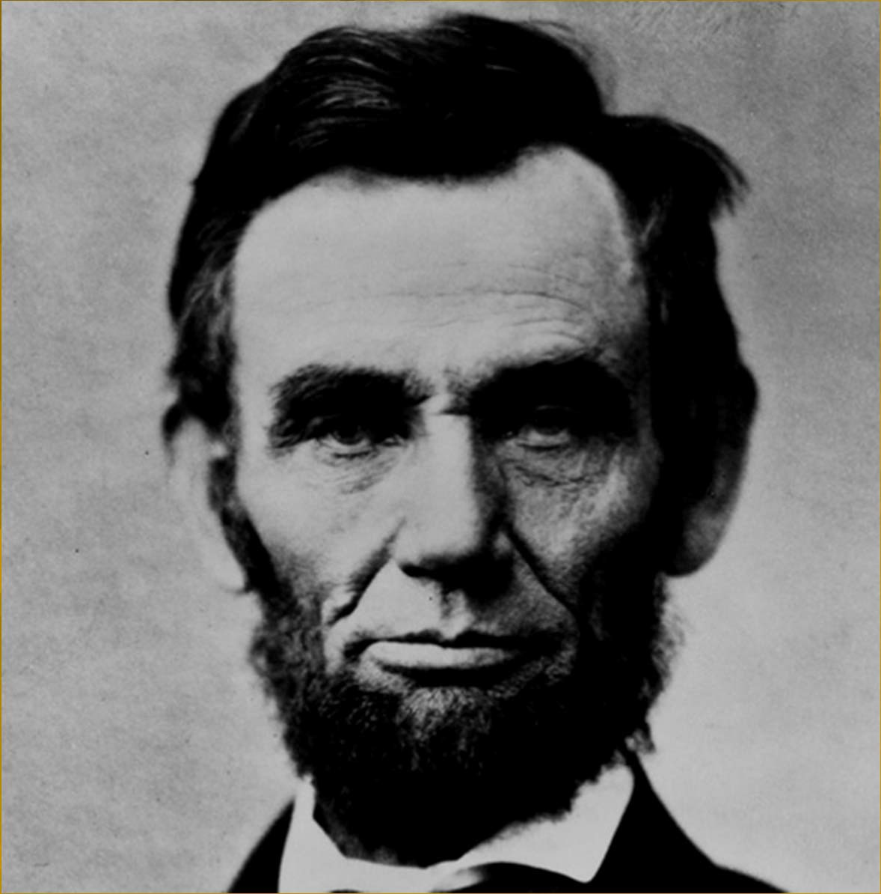
KEEP THESE QUESTIONS IN MIND AS YOU VIEW THIS PRESENTATION:
How did the ideas expressed in the Emancipation Proclamation and the Gettysburg Address support the North’s war aims?
What was Lincoln’s vision of the American nation as professed in the Gettysburg Address?

Slide 3
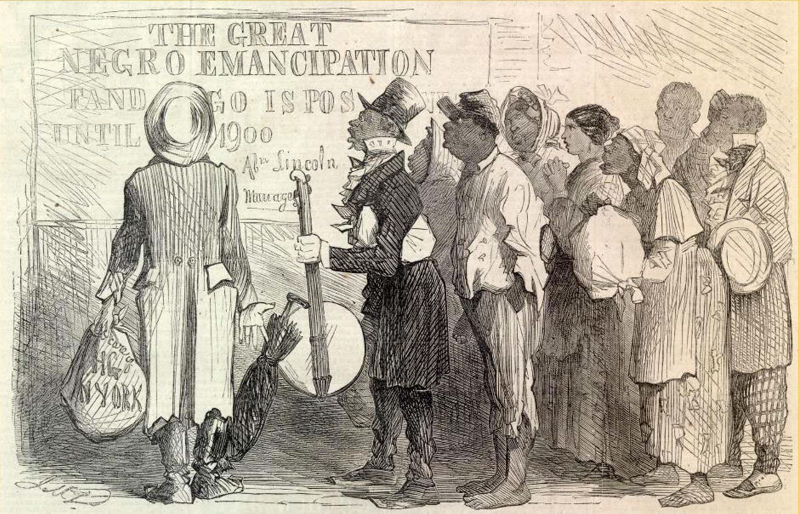
EMANCIPATION PROCLAMATION
Came after the Battle of Antietam; it was a military, political and foreign affairs policy.
Freed only those slaves located in "rebelling" states (seceded Southern states) – not the border states- hoping to encourage slave insurrection, a military goal.
It also allowed for the enlistment of African American soldiers in the Union Army

Slide 4
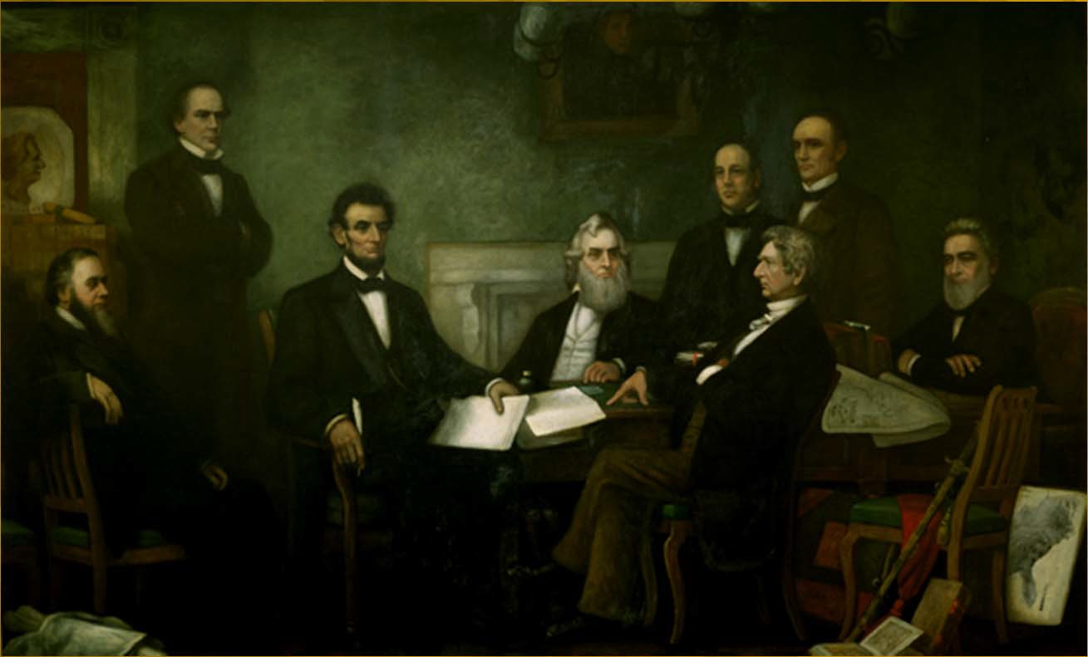
EMANCIPATION PROCLAMATION
Made the destruction of slavery a Northern war aim- a political goal.
Discouraged any interference of foreign governments- as France and Britain were opposed to slavery- they would not assist the Confederacy (foreign policy).
Here, Lincoln discusses the proclamation with his cabinet – they didn’t really like the idea!

Slide 5
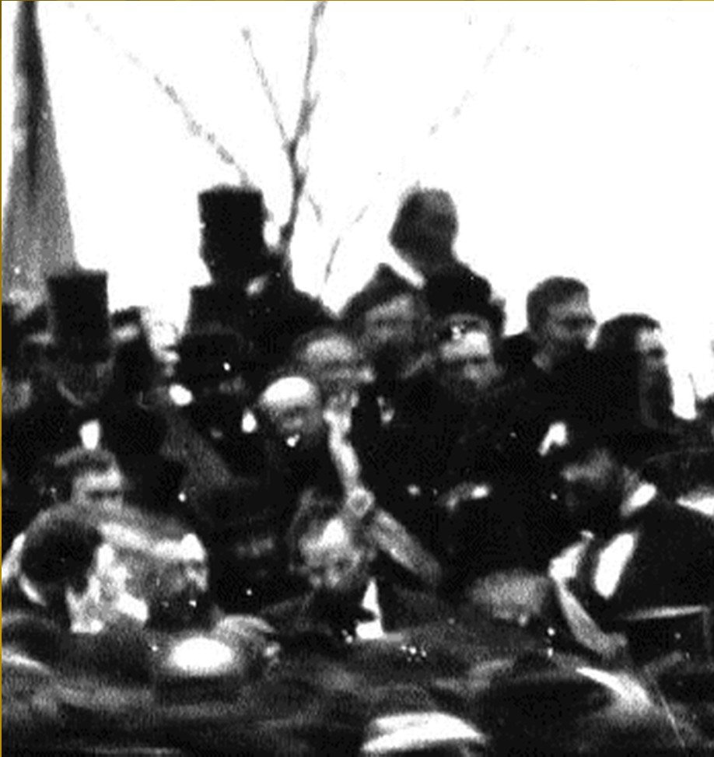
GETTYSBURG ADDRESS
Lincoln’s Gettysburg Address said the United States was one nation, not a federation of independent states. That was what the Civil War was about for Lincoln: to preserve the Union as a nation of
the people, by the people, and for the people.
The only known photograph of Lincoln as he helped to dedicate the ground at Gettysburg as a national
cemetery.

Slide 6
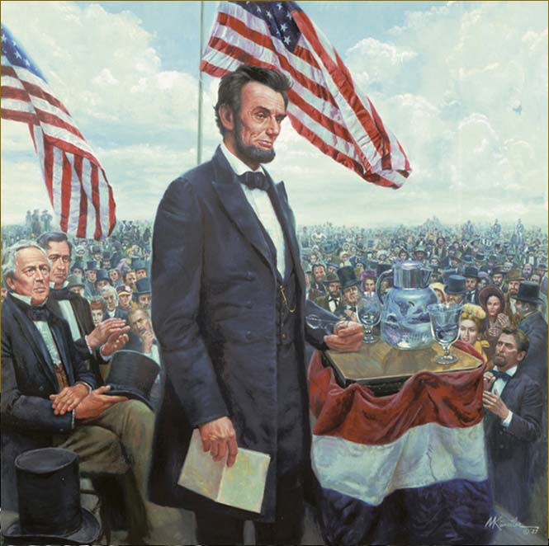
GETTYSBURG ADDRESS
Lincoln described the Civil War as a struggle to preserve a nation that was dedicated to the proposition that "all men are created equal" and that was ruled by a government "of the people, by the people, and for the people."
Lincoln believed America was "one nation," not a collection of sovereign states.
Southerners believed that states had freely joined the union and could freely leave.

Slide 7
Lincoln believed the Civil War was fought to fulfill the promise of the Declaration of Independence and was a second American Revolution. He described a different vision for the United States from the one that had prevailed from the beginning of the Republic to the Civil War.

Slide 8
Full Text of Address:
Four score and seven years ago our fathers brought forth, upon this continent, a new nation, conceived in Liberty, and dedicated to the proposition that all men are created equal. Now we are engaged in a great civil war, testing whether that nation, or any nation so conceived, and so dedicated, can long endure. We are met here on a great battlefield of that war. We have come to dedicate a portion of it as a final resting place for those who here gave their lives that the nation might live. It is altogether fitting and proper that we should do this.
But in a larger sense we can not dedicate - we can not consecrate - we can not hallow this ground. The brave men, living and dead, who struggled, here, have consecrated it far above our poor power to add or detract. The world will little note, nor long remember, what we say here, but can never forget what they did here. It is for us, the living, rather to be dedicated here to the unfinished work which they have, thus far, so nobly carried on. It is rather for us to be here dedicated to the great task remaining before us - that from these honored dead we take increased devotion to that cause for which they here gave the last full measure of devotion - that we here highly resolve that these dead shall not have died in vain; that this nation shall have a new birth of freedom; and that this government of the people, by the people, for the people, shall not perish from the earth.

