Slide 1
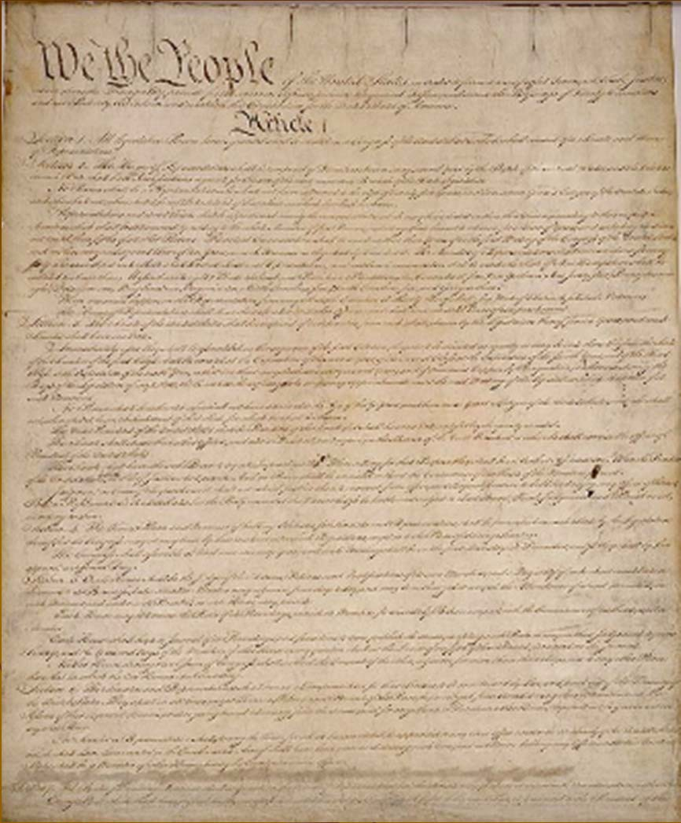










VUS5a
The First Attempt at Democracy
“Is it better to exchange rule by one tyrant living 3,000 miles away for rule by 3,000 tyrants living one mile away?”

Slide 2













As you view this slide show, keep these questions in mind.
How did America's pre-Revolutionary relationship with England influence the structure of the first national government?
What weaknesses in the Articles of Confederation led to the effort to draft a new constitution?

Slide 3
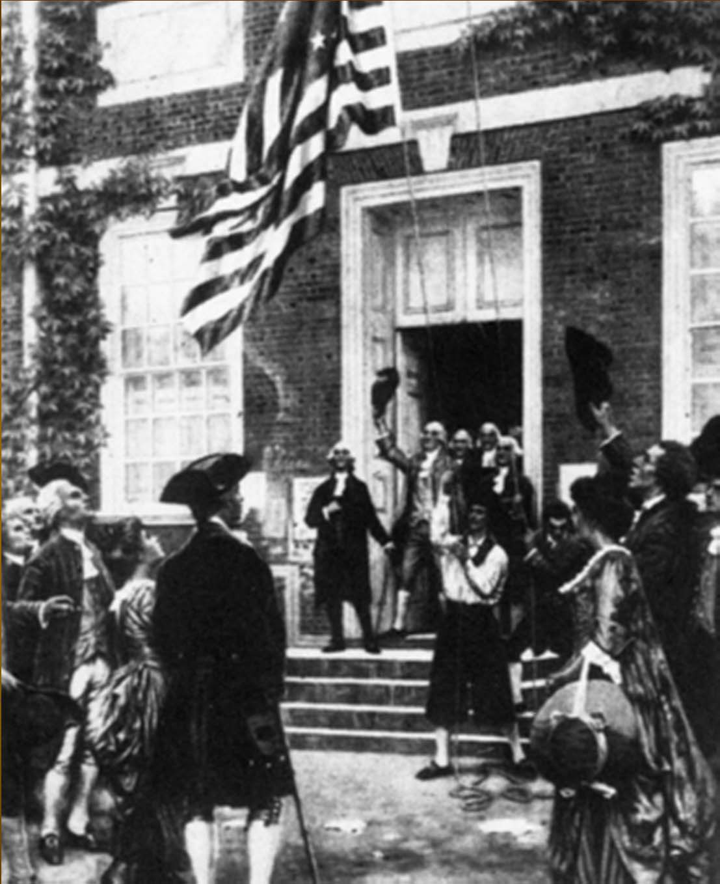







During the Constitutional Era, the Americans made two attempts to establish a workable government based on republican principles.
The first one FAILED!

Slide 4












American political leaders, fearful of a powerful central government like England’s, created the Articles of Confederation, adopted at the end of
the Revolutionary war.

Slide 5
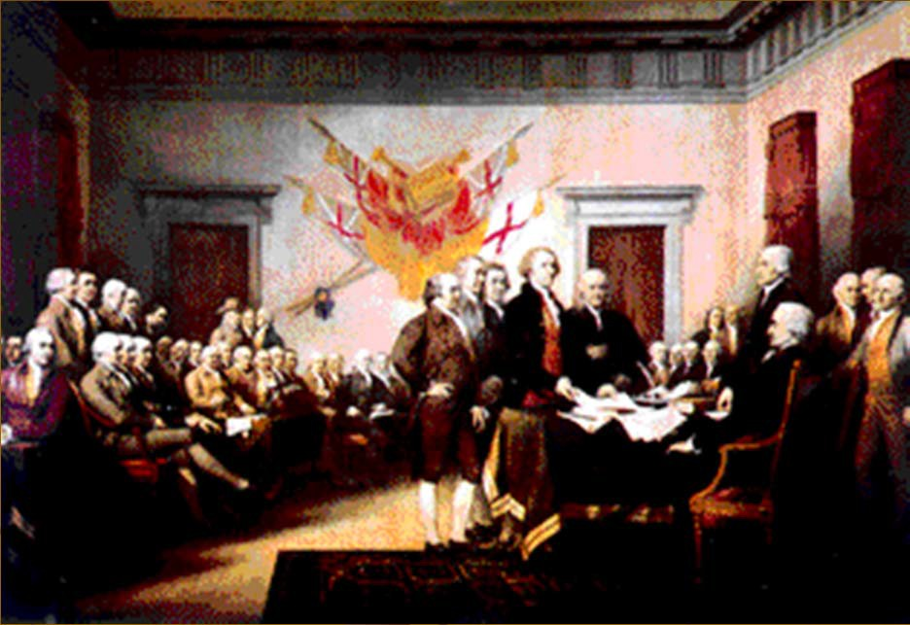







Our First Attempt: The Articles of Confederation
The leaders were fearful of a powerful government-they had seen their liberties crushed by the King.
The first government was designed to be weak to prevent “tyranny”
Most power would be shared with states.
The signing of the Declaration of Independence proved that Americans were opposed to a powerful government.

Slide 6
The Articles Were WEAK!
No power to tax or regulate commerce
No ability to create common currency
Each state had one vote- regardless of size
No executive branch or judicial branch
Difficult to pass laws and impossible to amend
Shared too much power with states

Slide 7
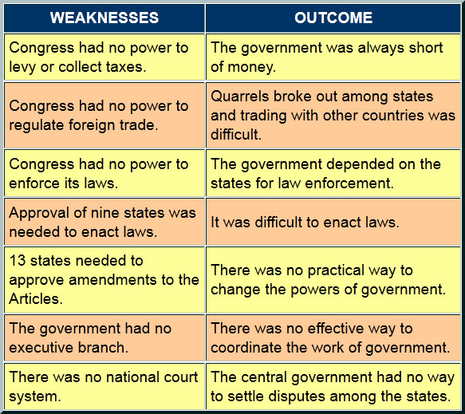

Slide 8
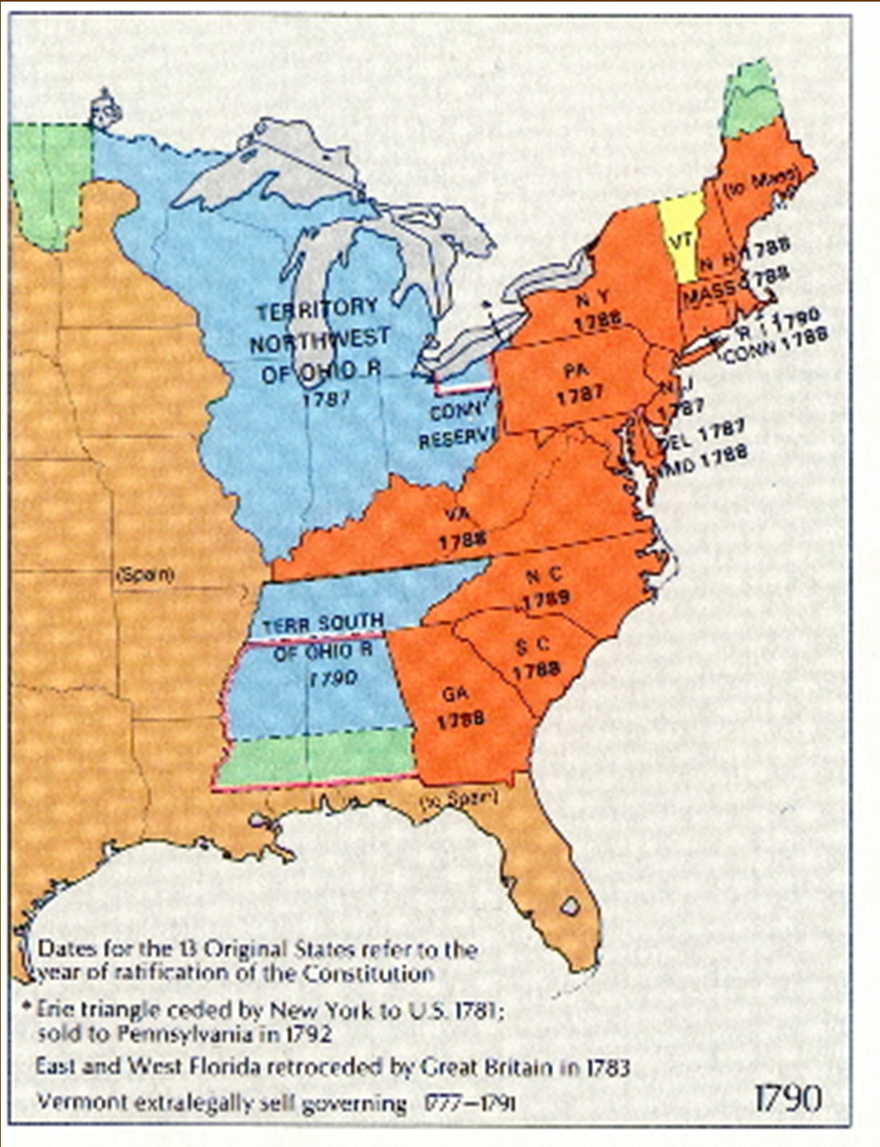






“What a victory for our enemy to find we can not govern ourselves!”
The territory was too vast to govern with a weak government.
The economy was in terrible shape.
Small border fights were occurring between some states.
There was no standard currency.
U.S. in 1790

Slide 9
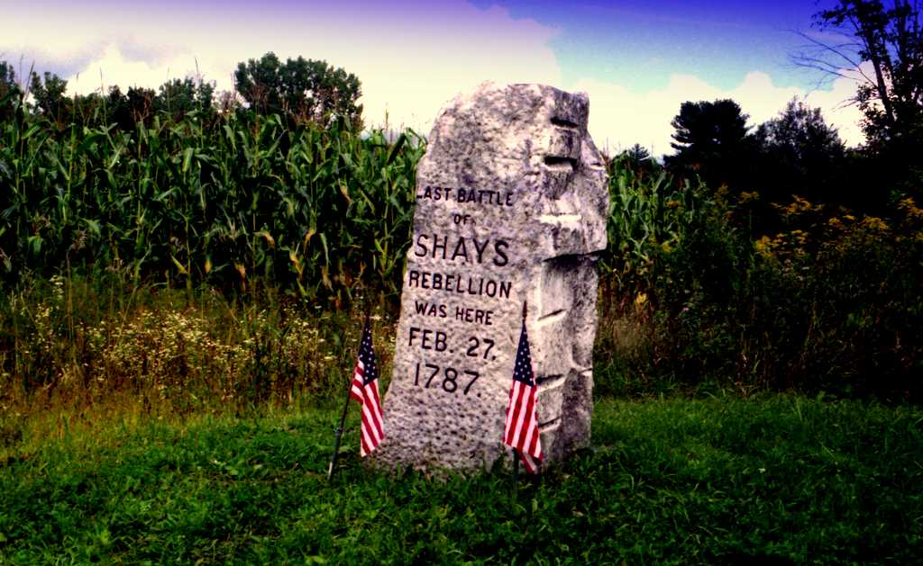
The Final Straw – Shay’s Rebellion

Slide 10
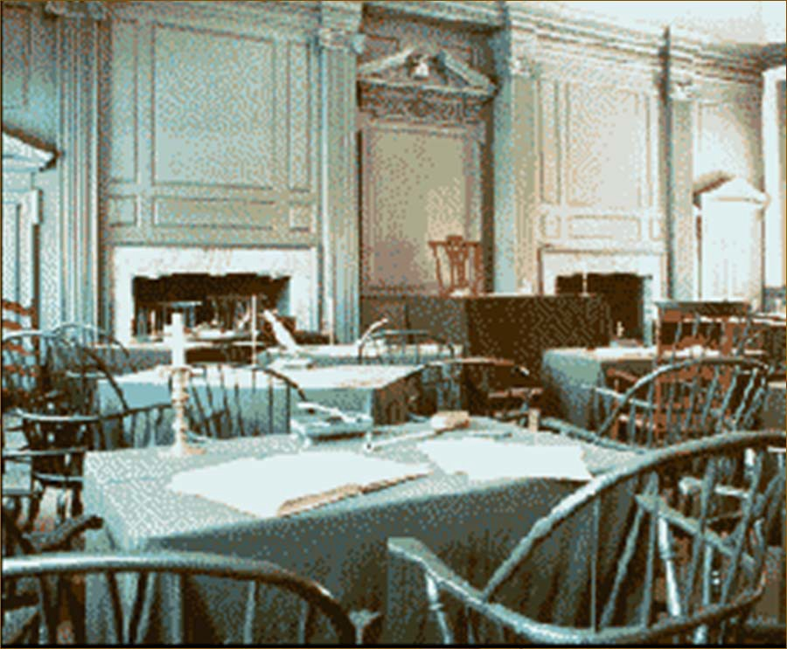





OOPS!
Time to try again:
A convention was called in 1787 to make necessary changes.
All states except Rhode Island sent delegates.
What they created in the room above still works today!

