Slide 1

VUS.11d
The Con tre
prisoners of war (POWs) during
World War II.
Geneva vention and the atment of

Slide 2
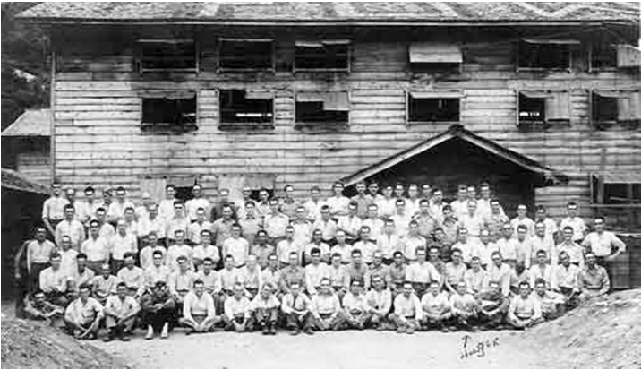
What was the purpose of the Geneva Convention?
A meeting in 1929 the Geneva Convention dealt with the Treatment of Prisoners of War and the document was signed by 47 governments.
The Geneva Convention attempted to ensure the humane treatment of prisoners of war by establishing rules to be followed by all nations.
Captured soldiers should be given food, shelter, clothing and medical treatment. (National Archives Photo)

Slide 3
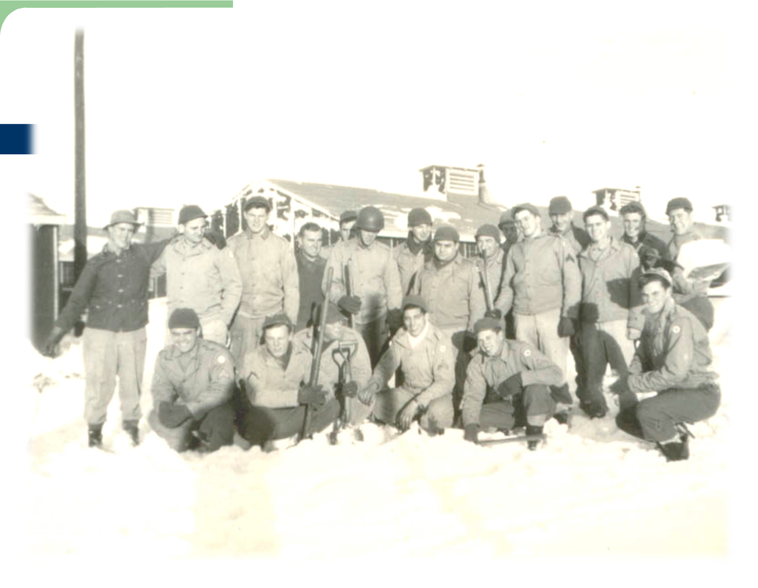
How did the treatment of prisoners differ?
The conduct of war often reflects social and moral codes of a nation.
The treatment of prisoners of war also often reflected the savage nature of the conflict.

Slide 4
The treatment of prisoners in the
Pacific Theater often reflected the savagery of the fighting there.
Japanese soldiers often committed suicide rather than surrender.
As fighting was more fierce, the treatment of POWs in Asia did not follow the accords from the Geneva Convention.

Slide 5
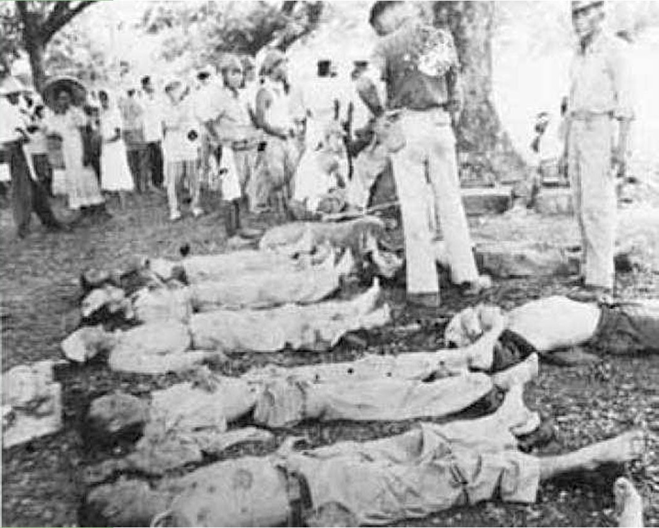
Bataan Death March:
American POWs suffered brutal treatment by Japanese after the surrender of the Philippines.
Nearly 70,000 American and Filipino soldiers were forced to surrender to the Japanese at Bataan in 1942. These troops were then marched through intense heat to a camp over 60 miles away. Somewhere between 5,000 and 11,000 soldiers died due to the lack of food and water.

Slide 6
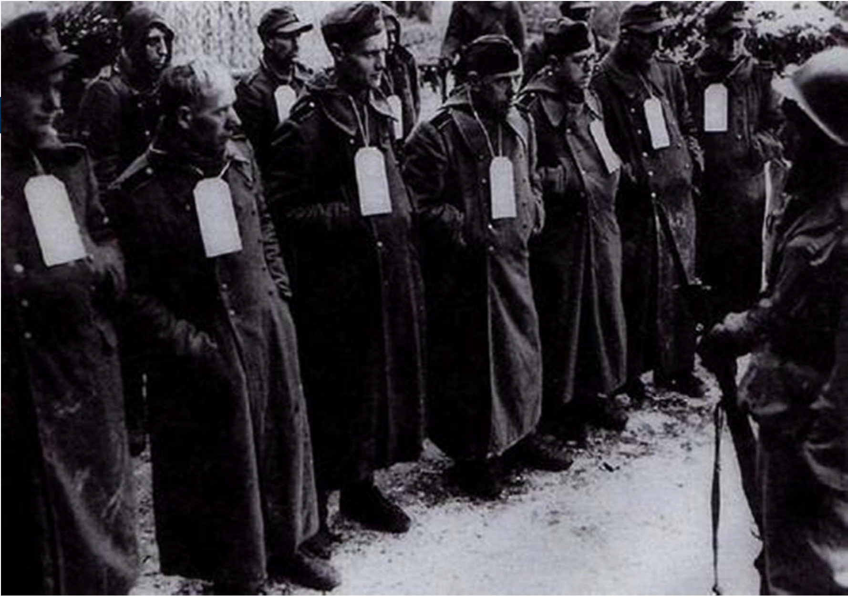
The treatment of prisoners in Europe more closely followed the ideas of the Geneva Convention

Slide 7
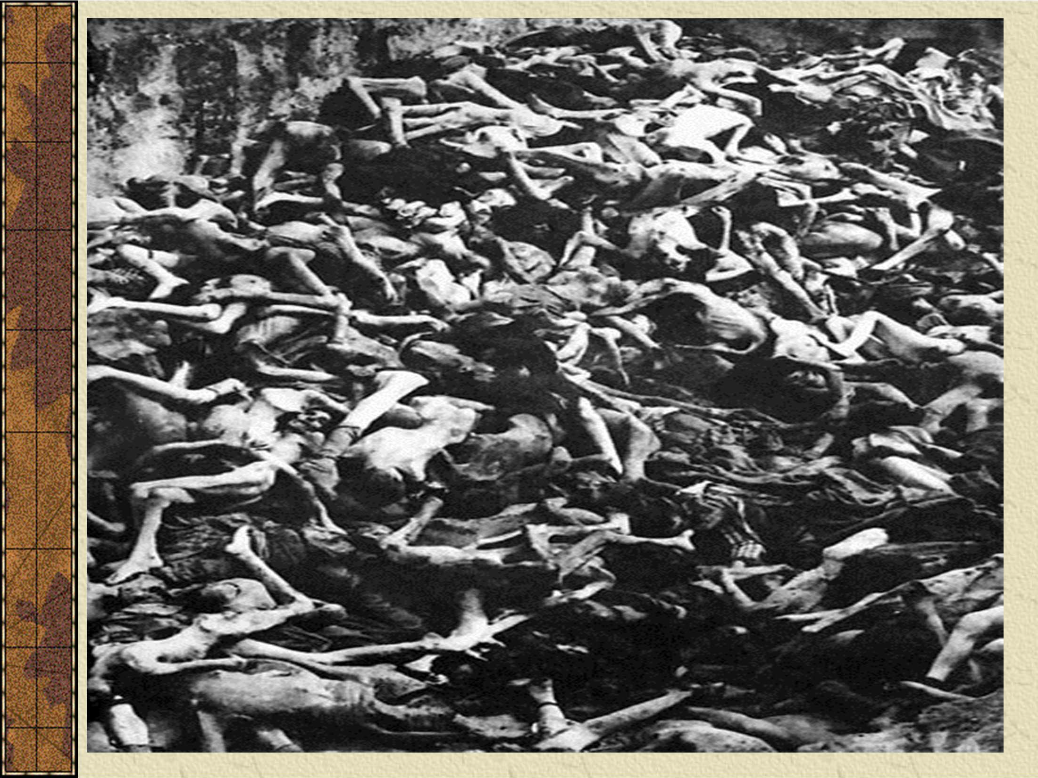
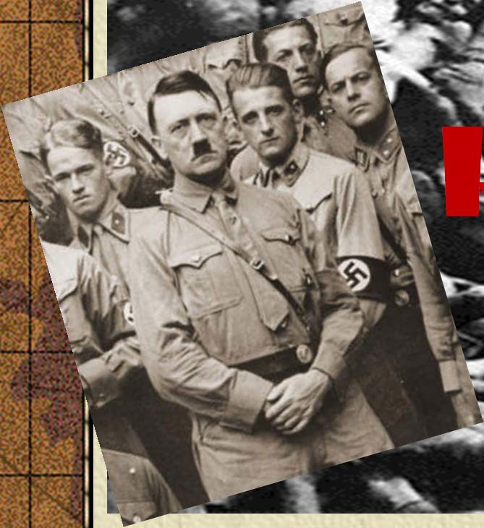
 | The Holocaust
H
itler’s “Final Solution"
VUS.11e

Slide 8
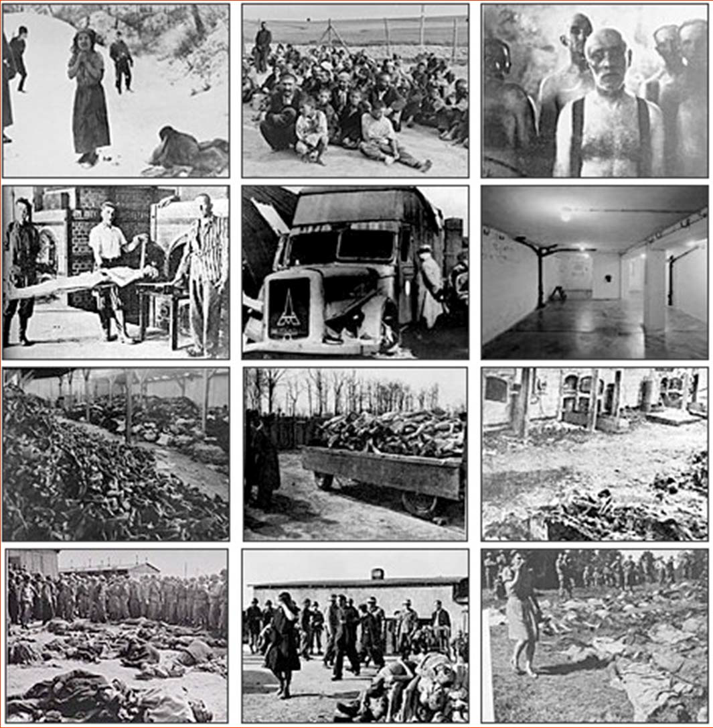

 | Specific groups, often the object of hatred and prejudice, face increased risk of discrimination during wartime. What was the Holocaust and who were its victims?
Image Credit: Romaniroots.webs.com

Slide 9


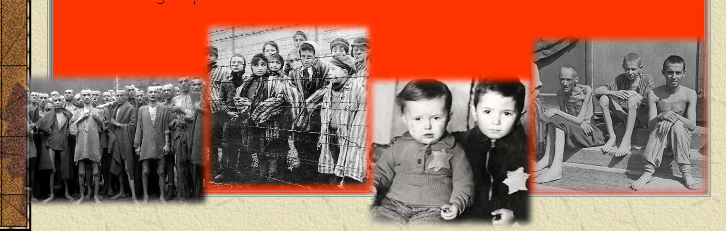
Terms to know
Holocaust: the murder of 11 million people in Europe under Hitler (6 million were Jews)
Genocide: The systematic and purposeful destruction of a racial, political, religious, or cultural group
Final Solution: Germany’s decision to exterminate all Jews
Concentration Camp: the many locations around Europe where people were forced to work and then exterminated

Slide 10

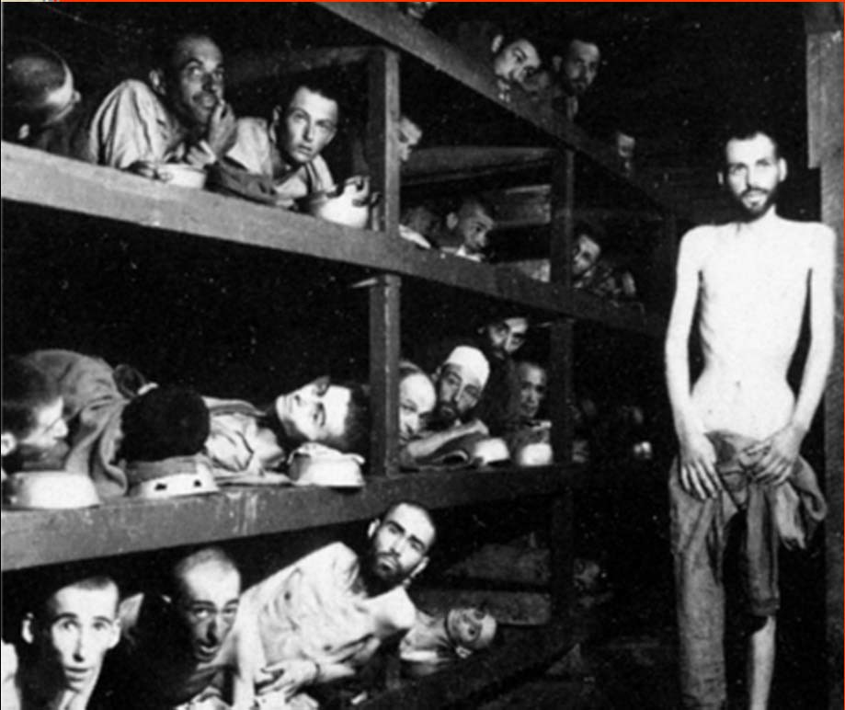

Affected groups
Jews: Hitler blamed the Jews of Europe for the problems in Germany, they became the scapegoat.
Poles: Hitler believed that the people from Poland should be the slaves of Germans
"These are slave laborers in the Buchenwald concentration camp near Jena; many had died from malnutrition when US troops of the 80th Division enter the camp." Germany, April 16, 1945. Pvt. H. Miller.
(National Archives)

Slide 11
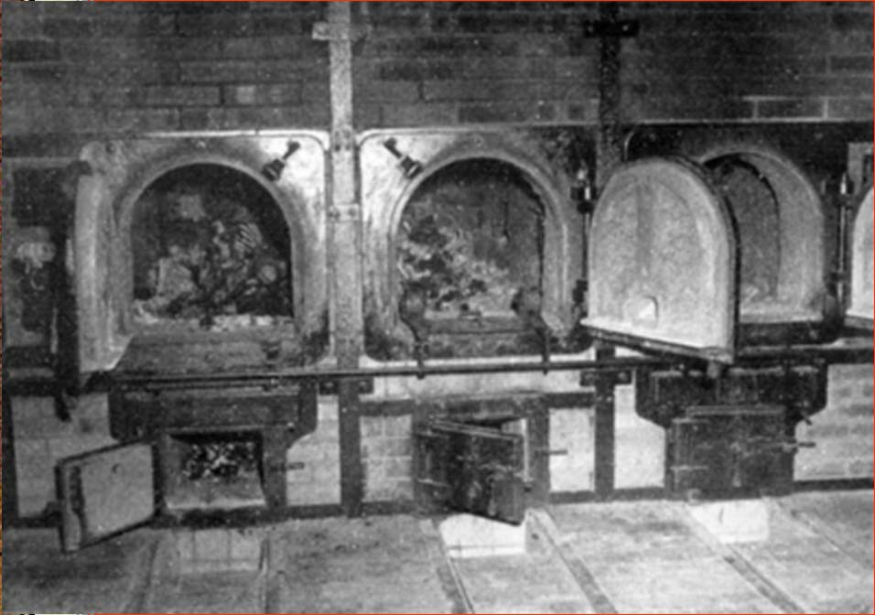



Affected groups
Slavs; Hitler believed the people of Eastern Europe were racially inferior
Gypsies: another minority group which traditionally suffered from discrimination in Europe
"Undesirables”: homosexuals, mentally ill, political dissidents (especially communists)
"Bones of anti-Nazi German women still are in the crematoriums in the German concentration camp at Weimar, Germany. Prisoners of all nationalities were tortured and killed." April 14, 1945. Pfc. W. Chichersky.
(National Archives)

Slide 12
What was the short-term and long- term significance of the Holocaust?

Slide 13
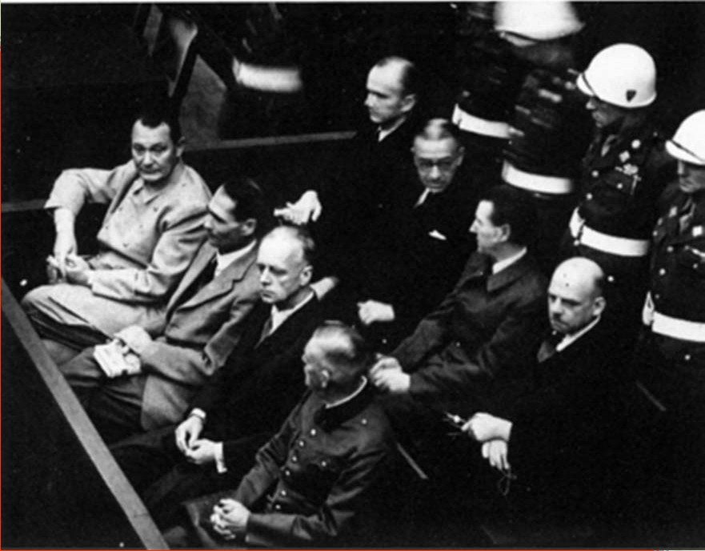
NUREMBERG TRIALS
In the Nuremberg trials, Nazi leaders and others were convicted of war crimes.
The Nuremberg trials emphasized individual responsibility for actions during a war, regardless of orders received.
The trials led to increased demand for a Jewish homeland. (Zionism)
Nuremberg Trials- Defendants
in their dock: Goering, Hess, von Ribbentrop, and Keitel in front row (National Archives)

Slide 14
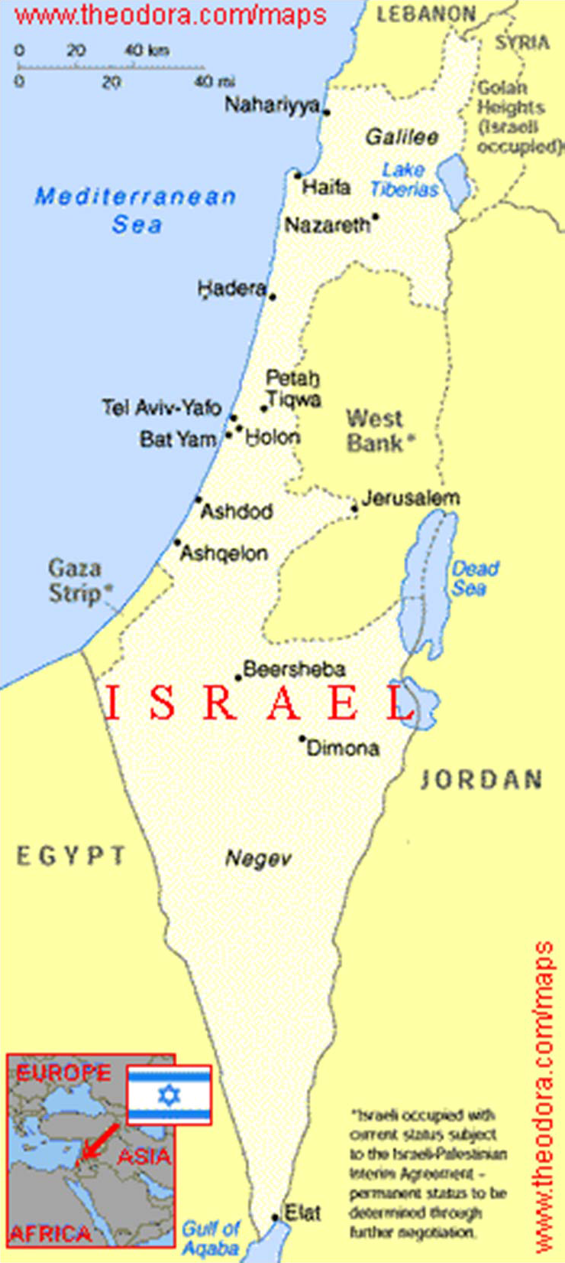
CREATION OF A NEW NATION: ISRAEL
Great Britain’s mandate, Palestine, from World War 1 was used to create Israel and Lebanon.
The U.S. supported the creation of a Jewish State, where Jews could be free from religious persecution of a government.
This act created animosity between the Arab nations of the Middle East and the U.S. which continues today.
Maps courtesy of www.theodora.com/maps, used with permission

