Slide 1
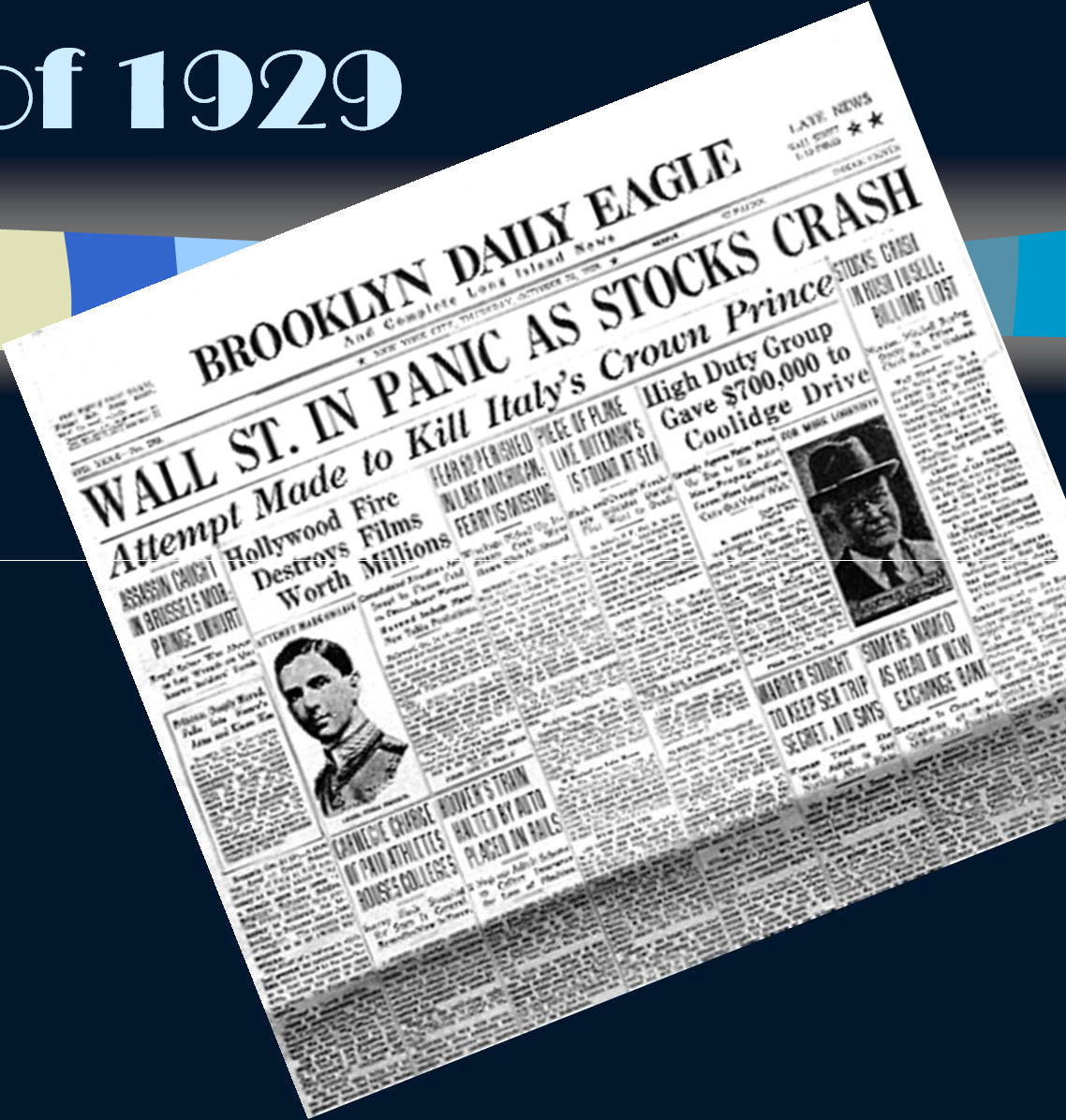

VUS10.b
The Causes and Consequences of the Stock Market Crash o
f 1929

Slide 2


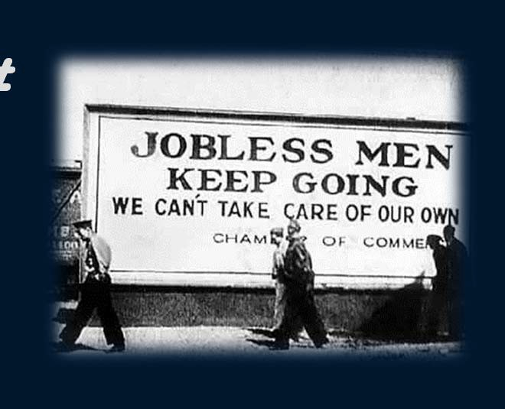
The United States emerged from WW1 as a global power.
The stock market boomed and
optimism of the 1920’s were
generated by investments made with
borrowed money.
When businesses failed, the stocks lost their value, prices fell, production slowed, banks collapsed and unemployment became widespread.

Slide 3
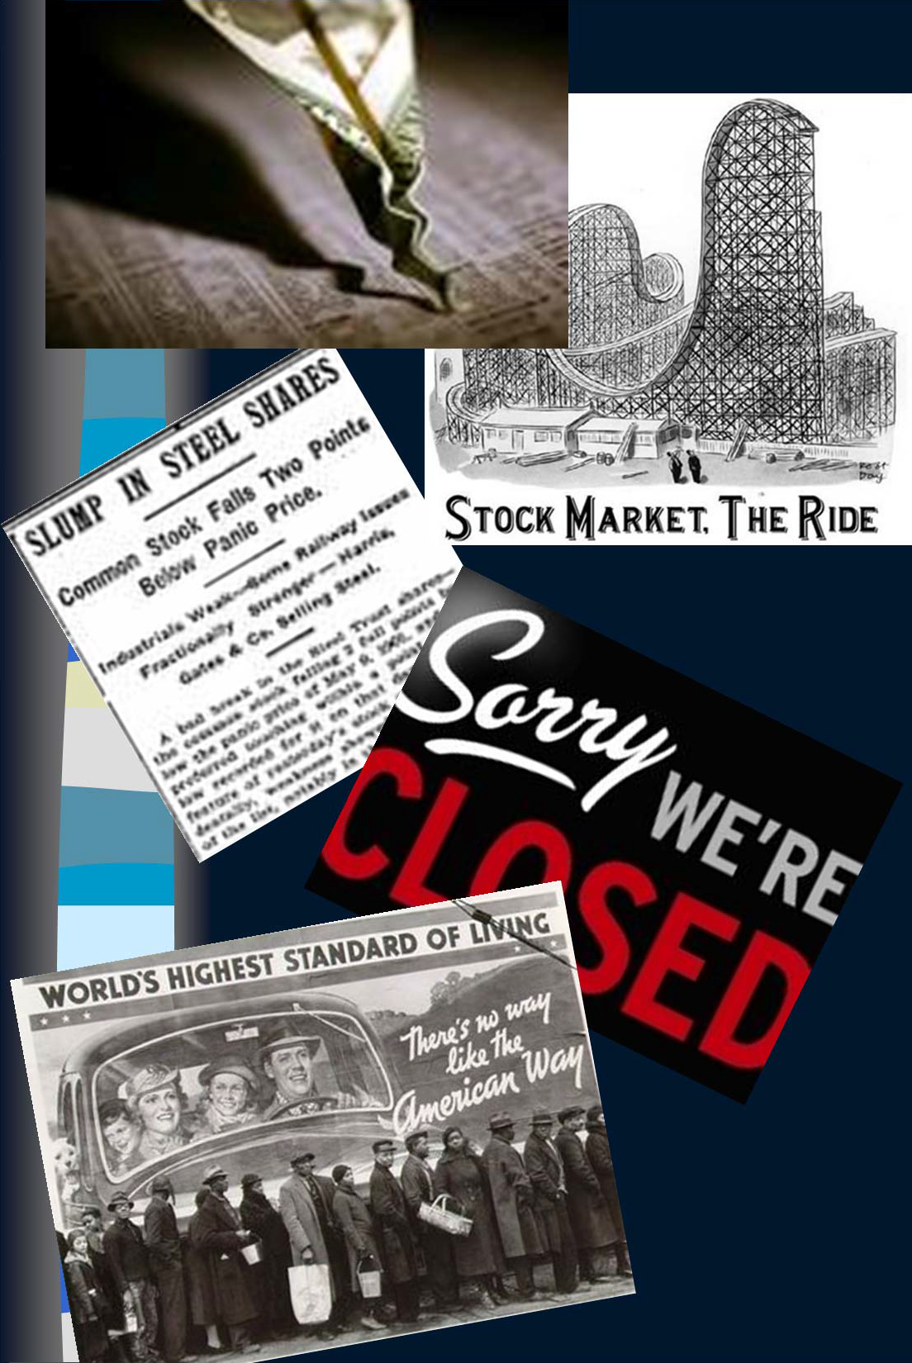
Specific Causes:
Business was booming, but investments were made with borrowed money (over speculation).
Excessive expansion of credit
Business failures led to bankruptcies
Bank deposits were invested in the market
Banks lost the money when the market collapsed.

Slide 4
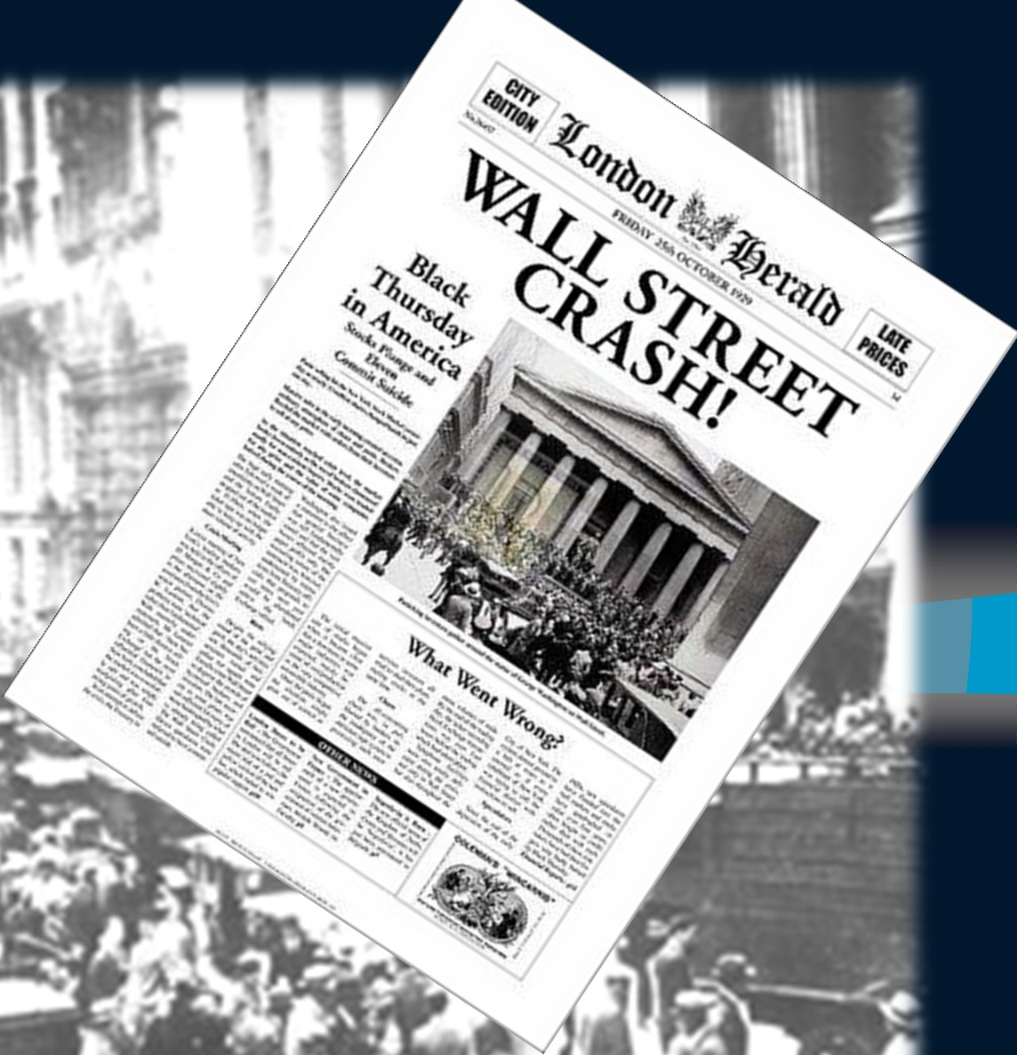
The Crash!
October, 1929

Slide 5
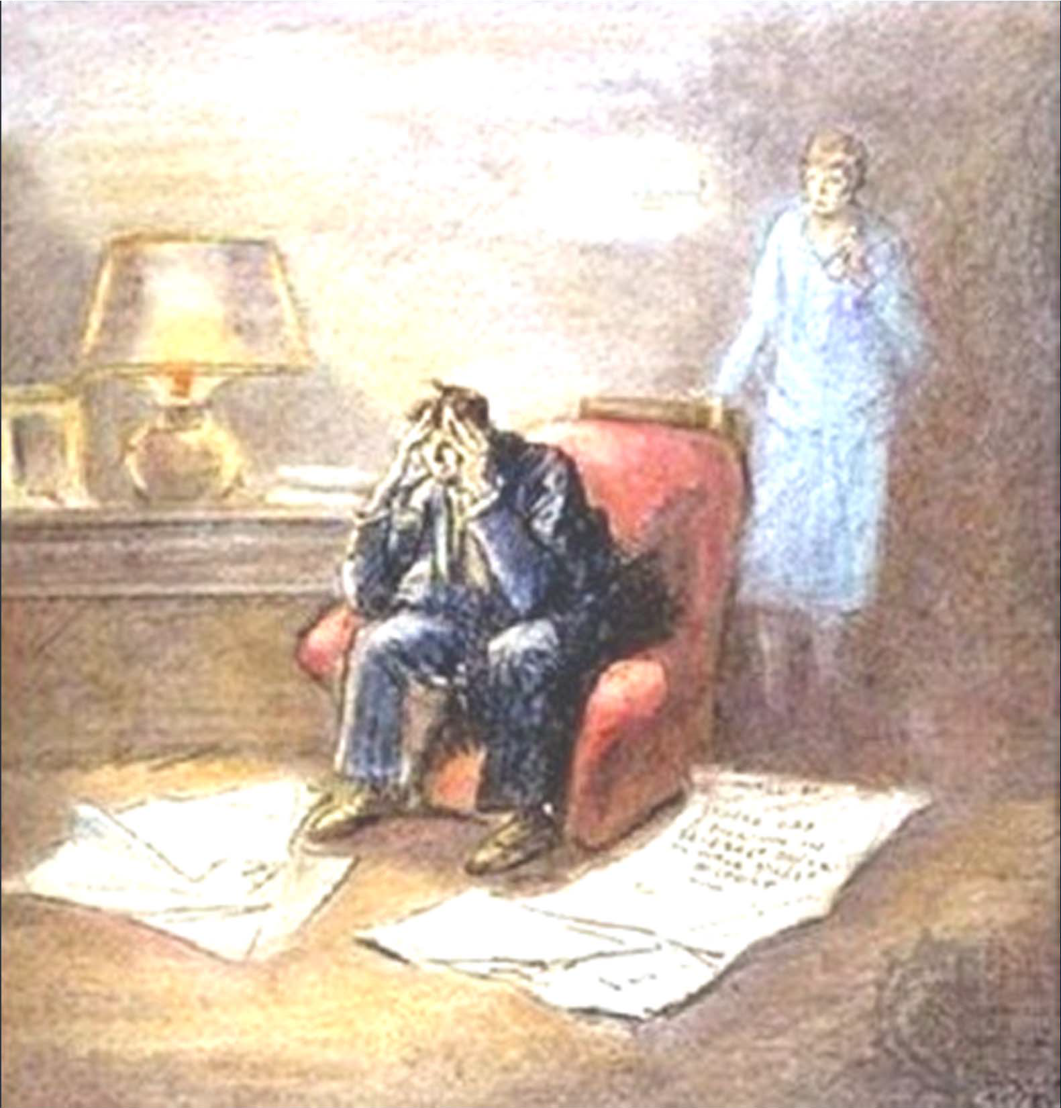
Consequences
Clients panicked, attempting to withdraw their money from banks – but there was no cash to give them.
No new investments in the banks.
Banks collapsed and fortunes were lost!

Slide 6
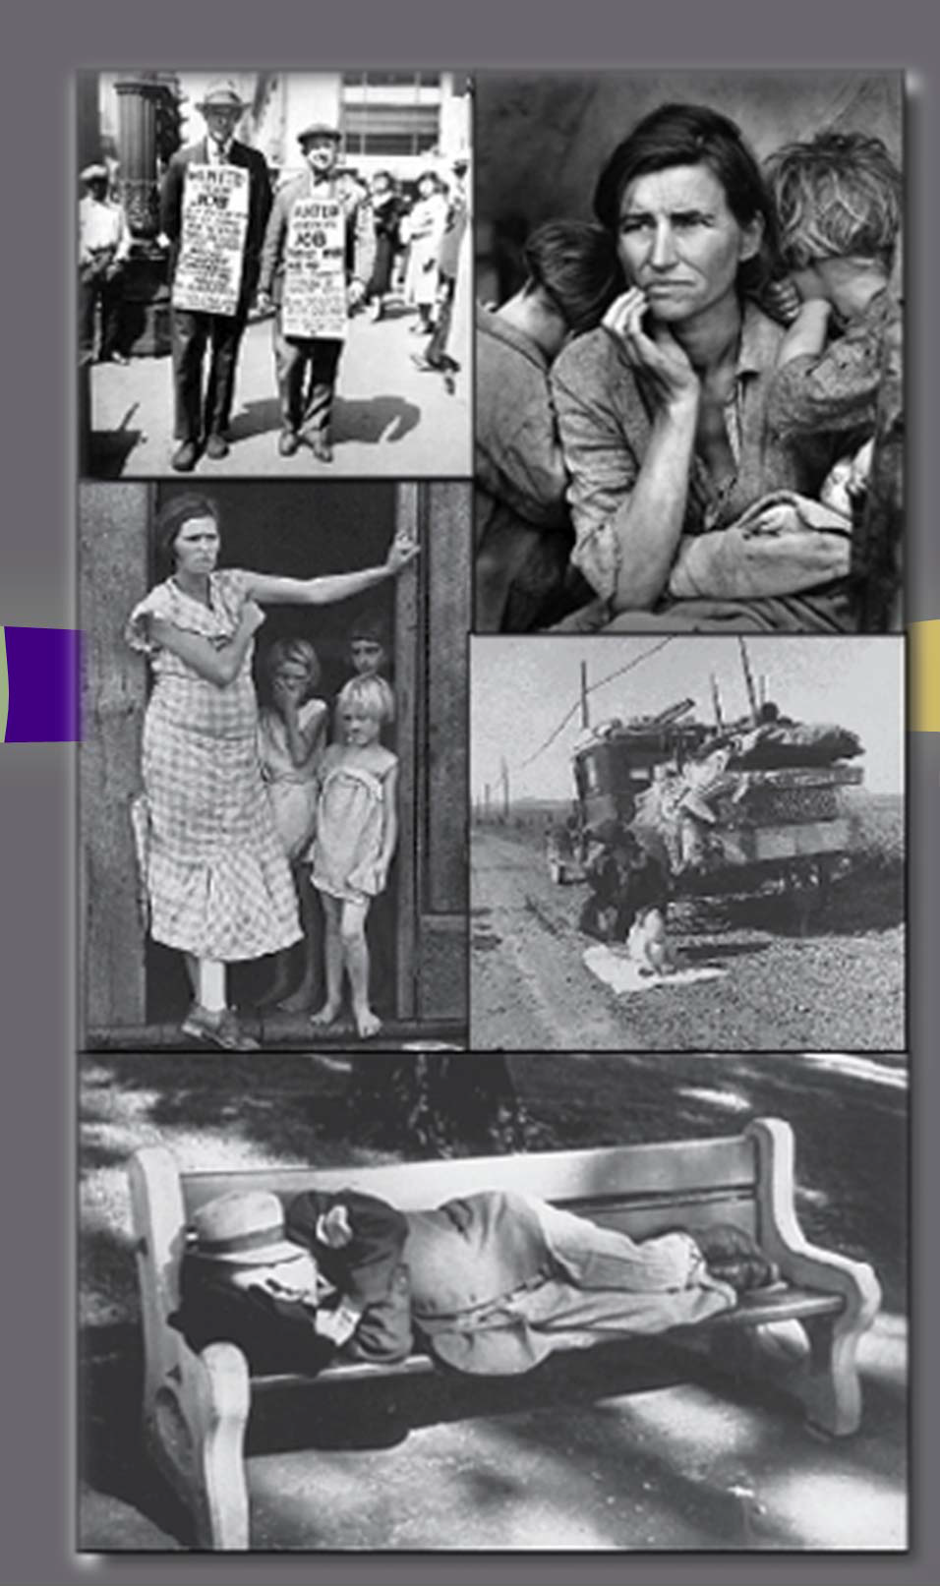

VUS10.c
HARDSHIPS OF

Slide 7
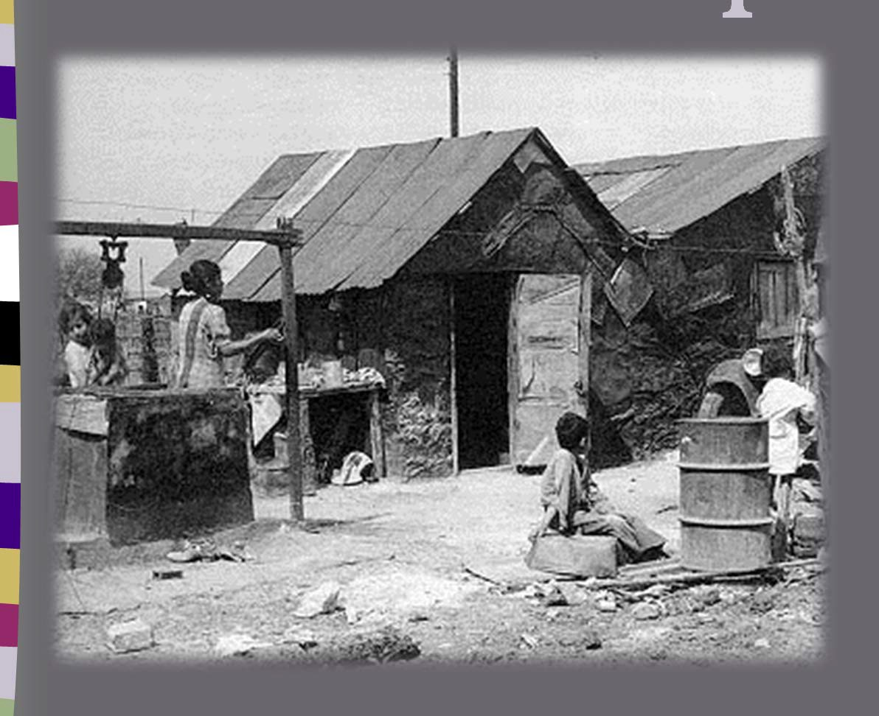

What were the causes of the Great Depression?

Slide 8

Causes of the Great Depression
Over speculation on stocks using borrowed money that could not be repaid when the stock market crashed in 1929 and stock prices collapsed. This was also called buying stocks “on margin”.

Slide 9


Causes of the Great Depression
Federal Reserve’s failure to prevent widespread collapse of the nation’s banking system in the late 1920s and early 1930s, leading to severe contraction in the nation’s supply of money in circulation.

Slide 10

Causes of the Great Depression
High protective tariffs that produced retaliatory tariffs in other countries, strangling world trade (Tariff Act of 1930, popularly called the Hawley- Smoot Act)
Congress tried to protect American Business by raising the price of imported goods– a devastating mistake!

Slide 11
How did the depression affect the lives of Americans?

Slide 12
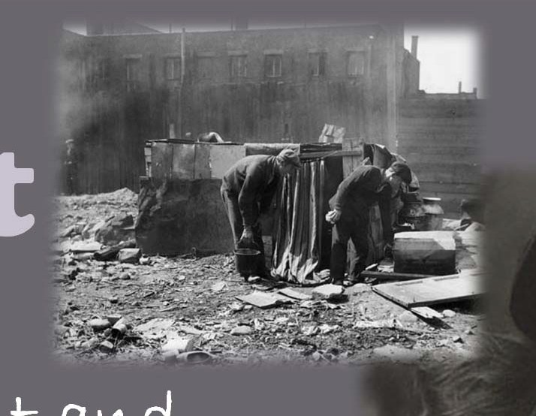
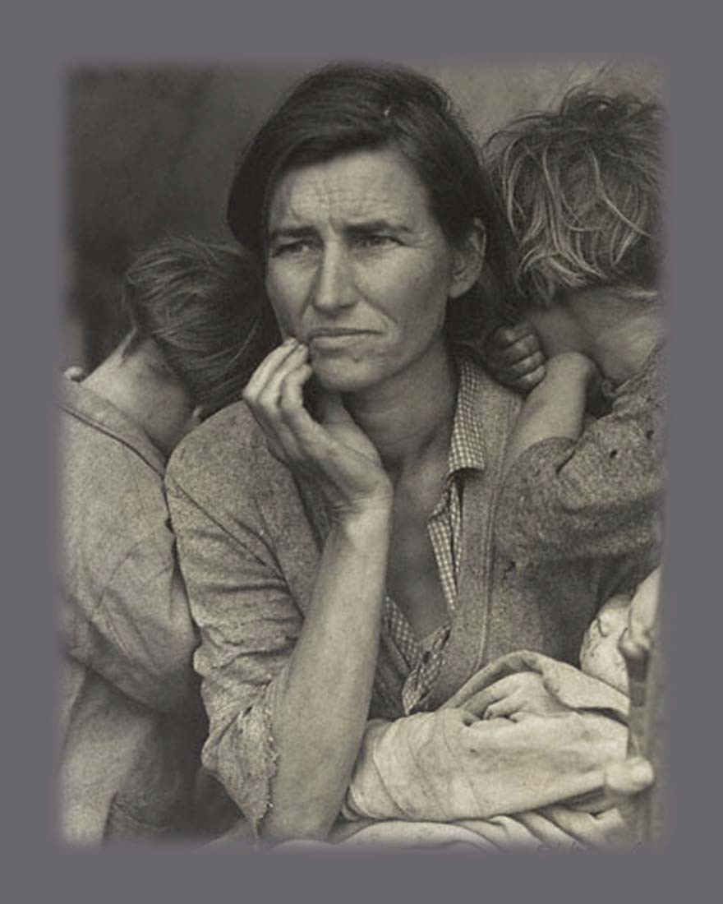
Impac
t
Unemployment and homelessness
Collapse of financial system (bank closings caused
investors to lose all the money they deposited).
This woman was left with her children as her husband went looking for work. Her look of uncertainty shows the dispair of the times!
Photo by Lange; National Archives

Slide 13
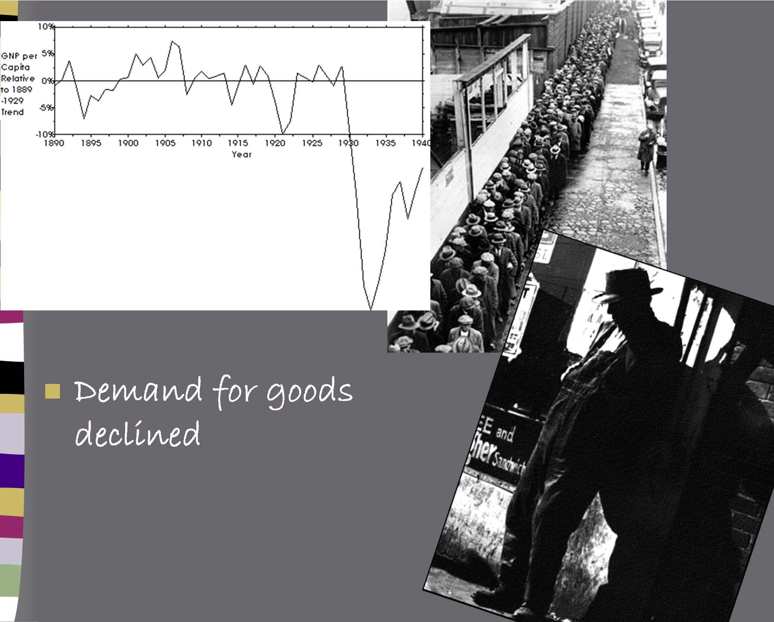
Impact
Demand for goods declined

Slide 14
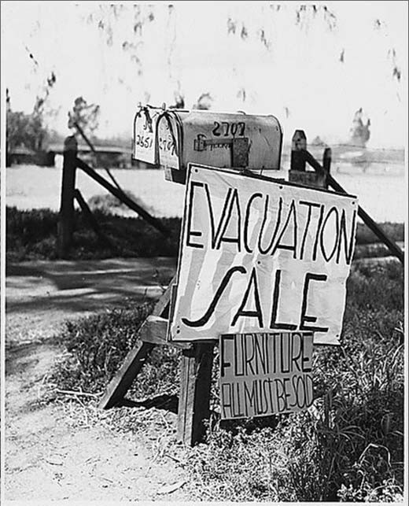
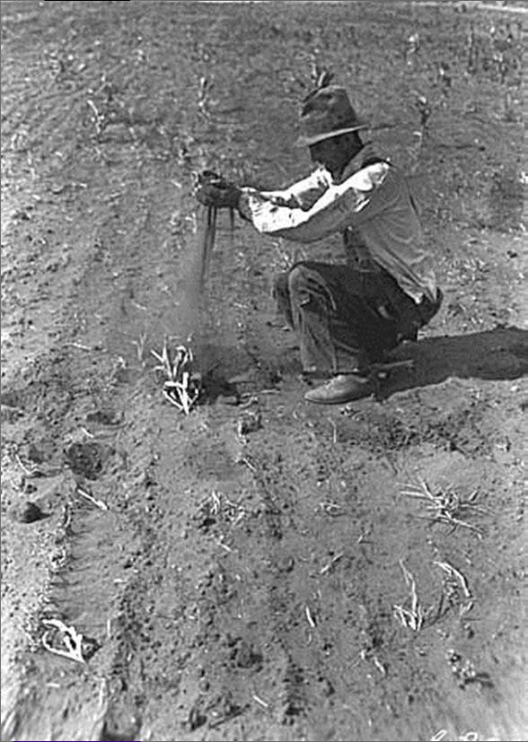
Impact
Political unrest (growing militancy of labor unions)
Farm foreclosures and migration as people looked for work
Farmers of the Great Plains also suffered from a devastating drought, called the “Dust Bowl”
Courtesy: Minnesota Historical Society

