Slide 1
The Constitution

Slide 2
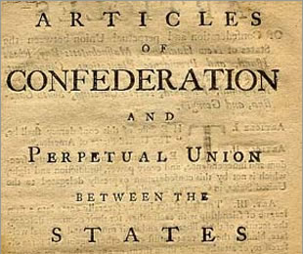
This Isn’t Working!
Problems with Articles:
- Very weak National government.
- Single house legislature
- No strong executive to enforce laws.
- Couldn’t print money
- each state printed their own money!
- Could not draft troops
- Could not tax
- Amendments required agreement of
all 13 State legislatures.

Slide 3
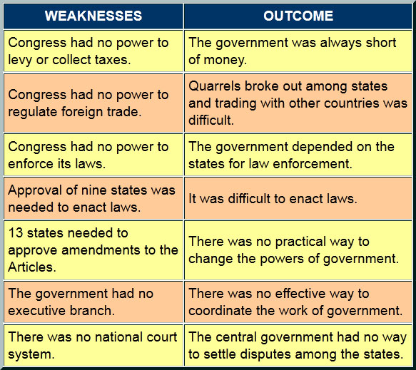

Slide 4
The Final Straw – Shay’s Rebellion

Slide 5
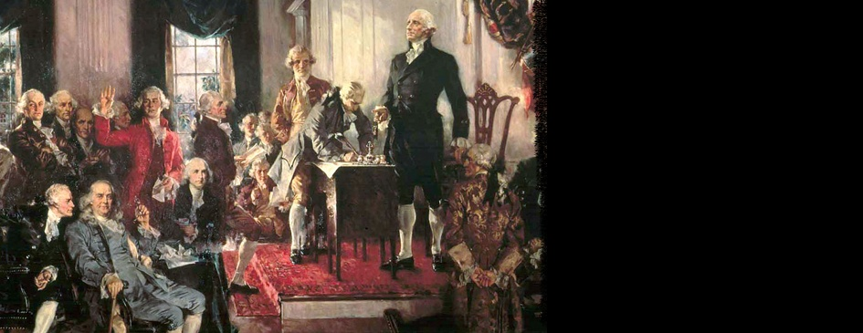
Constitutional Convention
Rhode Island says “No Thanks!”
Debate turns to Representation
- New Jersey Plan – We are all equal!
- Virginia – Bigger is Better!
Slave debate – 3/5^{ths} Compromise
Great Compromise – Connecticut has the answer!

Slide 6
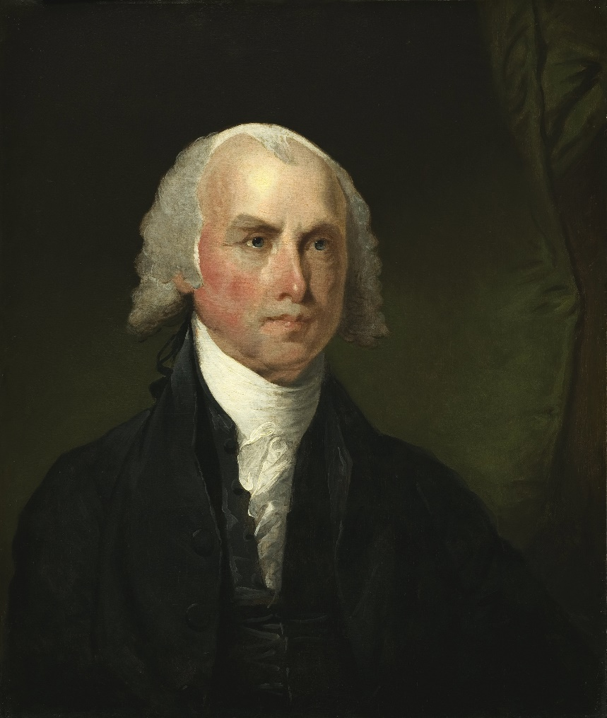
Huge Improvement!
Constitution is crafted by James Madison
- “Father of the Constitution”
Strong Federal government
- 6 principles – Republicanism, Federalism, Limited government, separation of powers, checks and balances, popular sovereignty.
- representative, power is spread, just enough control, protection against tyranny, and consent of the governed.

Slide 7
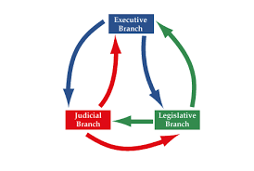
Separation of Powers
Article I – Established Congress
- House of Reps. – Population based
- Senate – 2 per state. No more no less.
- In practice, the most powerful.
Article II – Executive Branch
- President – Commander in Chief
Article III – Judicial Branch
- Supreme Court
- Congress empowered to create lower courts.

Slide 8
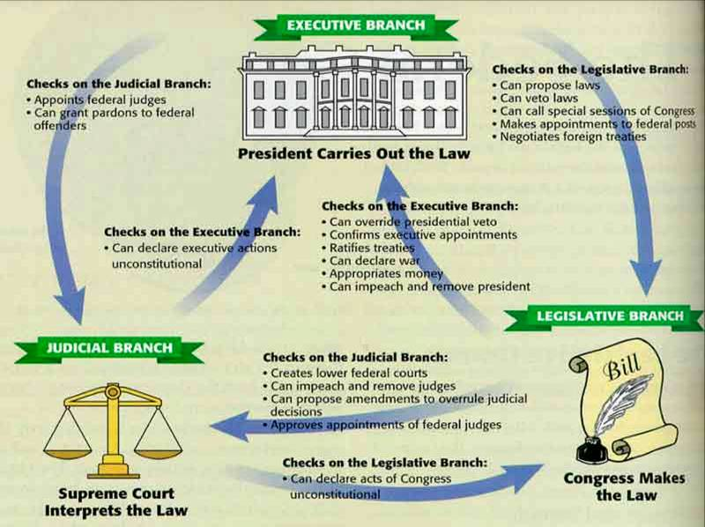

Slide 9
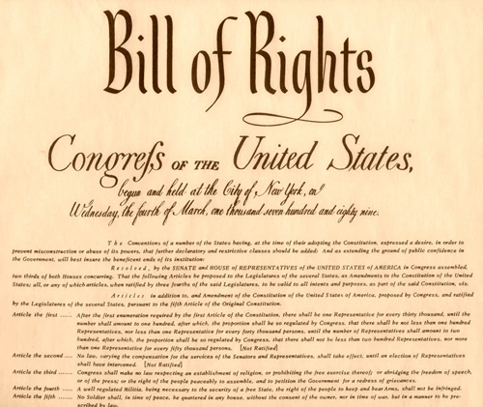
“…for our posterity”
Amendment process
- Requires 2/3rd vote of both House and Senate.
Ratification process
- approval of 2/3 of all state legislatures.
Judicial Review
- eventual scrutiny by the Supreme Court.

Slide 10
Not A Sure Thing!
Federalists
Anti-Federalists
Favored a strong Federal Government to run the country
Weaken the power of the States
Protected by the Structure
Pro- State Governments
Anti-Executive – “Hey we just left this!”
“What about the little guy?”

Slide 11
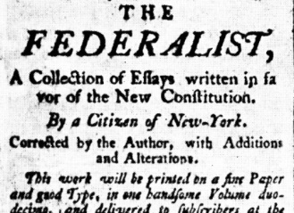
The Debate Rages
Federalist Papers – series of essays in big city newspapers, most notably New York.
- John Jay, Alexander Hamilton, James Madison
- argues each point in the argument against a federal government.
Bill of Rights – first 10 amendments to the Constitution.
- protects individual rights

