Slide 1
The Bureaucracy
The 4th Branch

Slide 2
Max Weber’s Definition:
“A hierarchical authority structure that uses task specialization, operates on the merit principle and behaves with impersonality to govern modern states.”

Slide 3
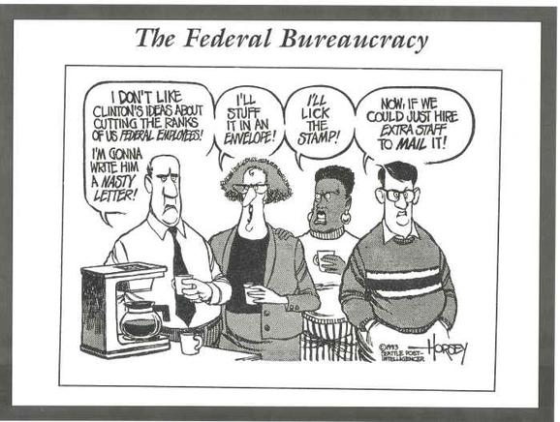
What Do They Do?
Provide essential public services.
Possess expertise in their particular capacity.
Partners with both Congress and the President in policy decisions.
Have discretion in carrying out policy.
Draw the attention of both congressional committees and interest groups.

Slide 4
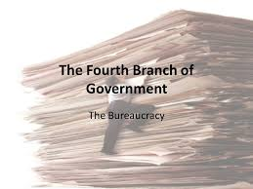
Is This A 4th Branch?
Created by Congress
- Establishes their budgets
- Creates the policies they administer.
Answer to the President
- Heads of all agencies are appointed by the President.
- Additional positions are appointed.

Slide 5
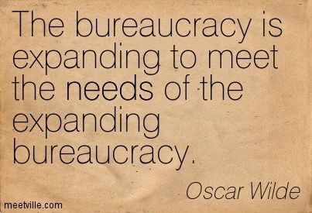
Is This A 4th Branch?
Two Schools of Thought …
Constantly seeking to expand their responsibilities and budget allowances.
Working hard to complete impossible missions assigned to it with little assistance from elected officials.

Slide 6
The Bureaucrats
Much more diverse labor force than our elected officials.
Staffed by a non-partisan system.
- Not a revolving door of individuals with allegiances to the party in power.
Once filled by the spoils system, positions now go to the most qualified.

Slide 7
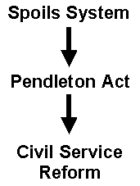
The Bureaucrats
Pendleton Civil Service Act
- created a civil service to ensure hirrings and promotions would be based on merit.
- result of a desire to create a stable and non-partisan labor force within government.

Slide 8
The Bureaucrats
Hatch Act – prevents government employees from actively participating in partisan politics while on duty.
- may not run for partisan elected office.
- National Security employees may never participate in political activities.

Slide 9
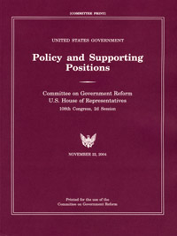
The Bureaucrats
The Plum Book
- a congressionally published list of the top positions in the Bureaucracy.
- includes the heads of 500 government agencies open to presidential appointments.
- approx. 2500 additional positions filled by the President.

Slide 10
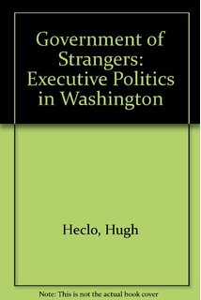
Plum Book Critics
Creates leadership of “in and outers.”
- Top leaders serve for brief periods of time.
Results in a “government of strangers.”
- Temporary leaders never know their subordinates.

Slide 11
Cabinet Departments
Headed by a Secretary chosen by the President, confirmed by the Senate.
Each Secretaty serves on the Cabinet.
Manages specific policy areas.
Each has its own budget and staffing.
Examples:
Department of Defense
Department of Health & Human Services

Slide 12
Independent Regulatory Commissions
Responsible for some segment of the economy.
Makes and enforces rules to protect public interest.
Judges disputes over these rules.
“Alphabet Soup” of government – agencies are often referred to by their abbreviations.
FRB – Federal Reserve Board
NLRB – National Labor Relations Board
FCC – Federal Communications Commission

Slide 13
Government Corporations
Essentially private companies (no stock).
Provide services that could be handled by the private sector.
Charge the government for their services.
- cheaper rates than consumers would pay
Tennessee Valley Authority (TVA)
- provides inexpensive electricity
Comsat – rents timeshare on NASA satellites.
US Postal Service – formerly a cabinet department.

Slide 14
Implementing Policy
Translating the goals and objectives of a policy into an operating, ongoing program.
Involves one or more of the following:
- creation of a new agency
- assigning a new responsibility to an existing agency
- establishing operational rules and guidelines.
- coordination of resources

Slide 15
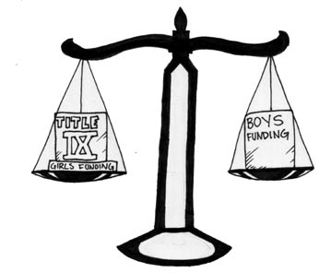
A Difficult Task
Lack of clarity
- legislation carries broad goals, narrow instructions
Example: Title IX
- intended to prevent gender discrimination in education.
Athletic supporters lobbied to extend the act to women’s athletics.
- The result changed the landscape of college athletics.

Slide 16
A Difficult Task
Lack of resources
Standard Operating Procedures – essential to streamline operations.
- often results in “red tape” that must be overcome to get things accomplished. Things move slowly.

Slide 17
A Difficult Task
Administrative Discretion
- agencies realize great autonomy when rules do not clearly apply to a situation.
- effectiveness of which fluctuates among agencies.
- How much autonomy do we want to afford the IRS?

