Slide 1
Influential Philosophies
What shaped our Founding Fathers?

Slide 2
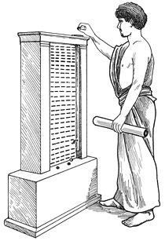
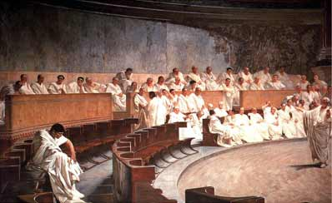
Direct v. Indirect Democracy
Greece
Rome

Slide 3
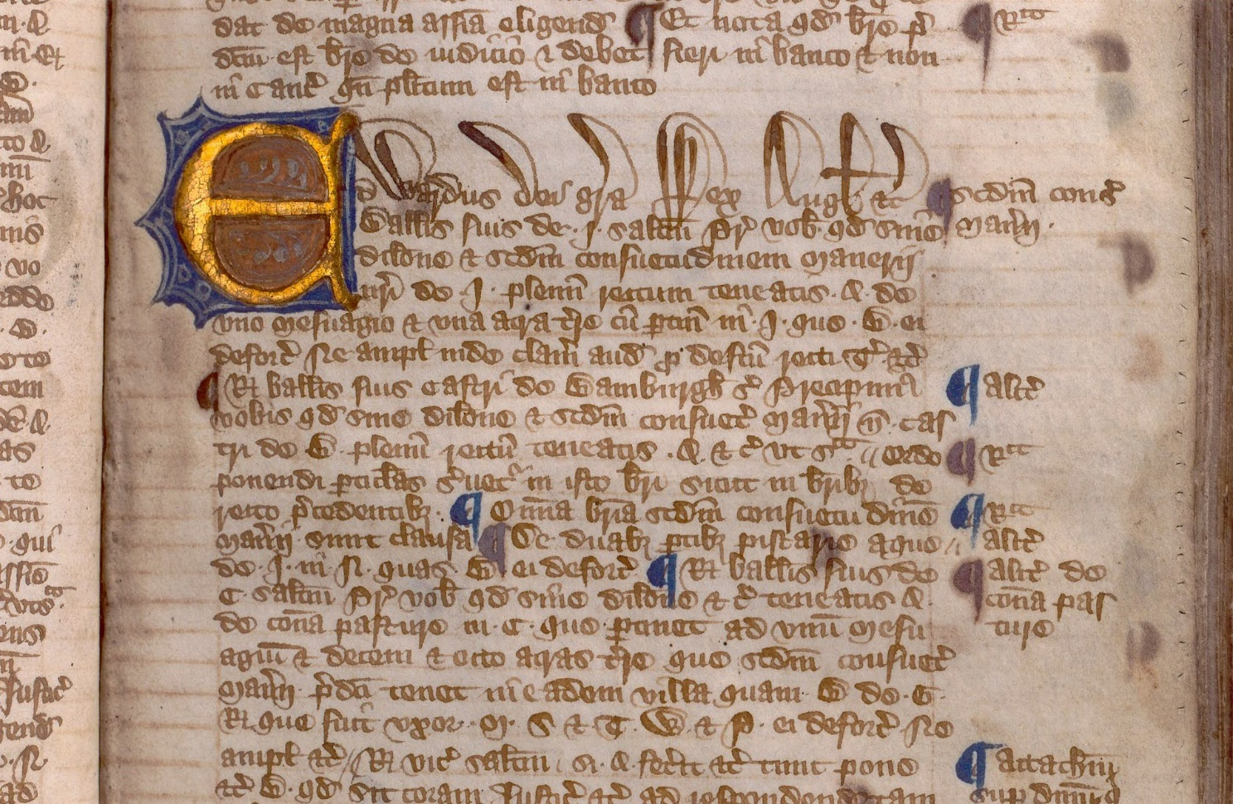
Magna Carta
Limited the power of the King
Fundamental rights
- trial by jury, due process of law

Slide 4
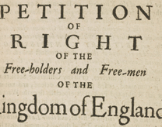
English Petition of Right
- Rule of Law
Guarantees certain rights for the first time.
- protection against marshall law, quartering and security of private property.

Slide 5
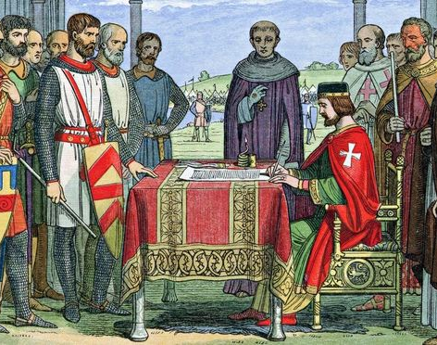
English Bill of Rights
Limited power of the monarchy.
No standing army in peacetime.
Free elections.
Parliamentary checks on power.

Slide 6
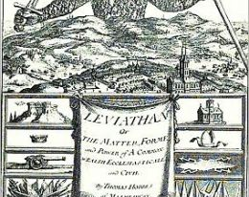
Key Figures
John Locke – limited government.
Thomas Hobbes – consent of the governed. The social contract.
Montesquieu – separation of powers.
Jean-Jacques Rousseau – all men are equal.

Slide 7
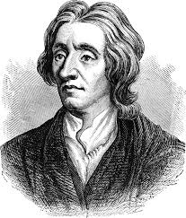
These Ideals Come to the Colonies
Rights of Englishmen extended to the colonies.
Jean Jacques Rousseau – all men are equal.
John Locke – natural rights of life, liberty and property.

