Slide 1
Members of Congress

Slide 2

The Senate
“Gentlemen’s Club”
100 Senators, two from each state, serve a 6 year term (no term limits)
Only 1/3 of Senate up for re-election every 2 years.
Senate is considered a “continuous body”
- provides stability
- considered less political.
- sheltered from influences.

Slide 3

The Senate
Longer terms, less turnover, more media attention, more prestigious
Less rules, more open talk
Qualifications:
30 years old
Live in state you represent
Be a citizen for 9 years

Slide 4
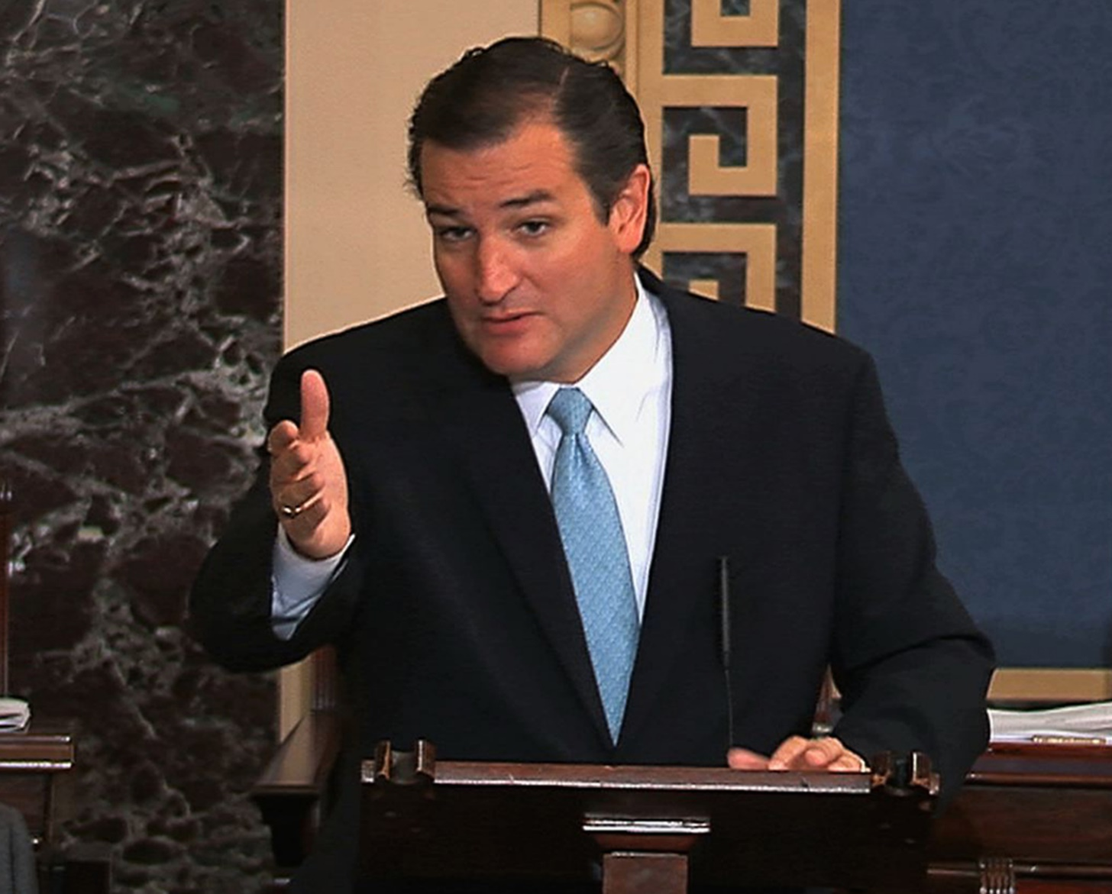
The Fillibuster
Tactic of the minority party.
Talking until majority of Senate agrees to abandon or modify a bill.
Filibusters have included corn bread recipes, phone book readings, fishing stories, etc.
Cloture: 60 senator vote to limit debate to 30 hours to avoid a filibuster.
Ted Cruz’ epic Obamacare fillibuster

Slide 5

House of Representatives
“The People’s House”
435 members, running every two years
- this means a Representative is ALWAYS running for reelection.
Power of the Purse - any bill that deals with money/budget must originate in the House of Representatives.
Strict rules on debate & amendments due to the large membership.

Slide 6

House of Representatives
Qualifications for House members:
25 years old
Citizen for 7 years
Live in the district you represent.
Smaller constituency (the citizens you represent)
- districts avg 710,767 people
- results in greater diversity in the House as opposed to the Senate.

Slide 7
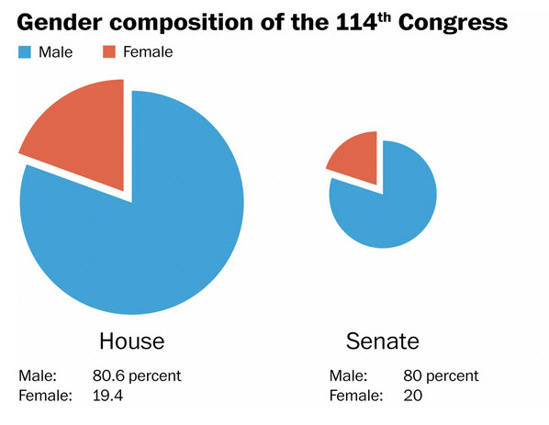
Representative Democracy???
Congress is a very poor representation of America
Race: Overwhelmingly Caucasian
- especially the Senate
Gender: 80% Male
Occupation: Vast majority are lawyers or businesspersons.

Slide 8
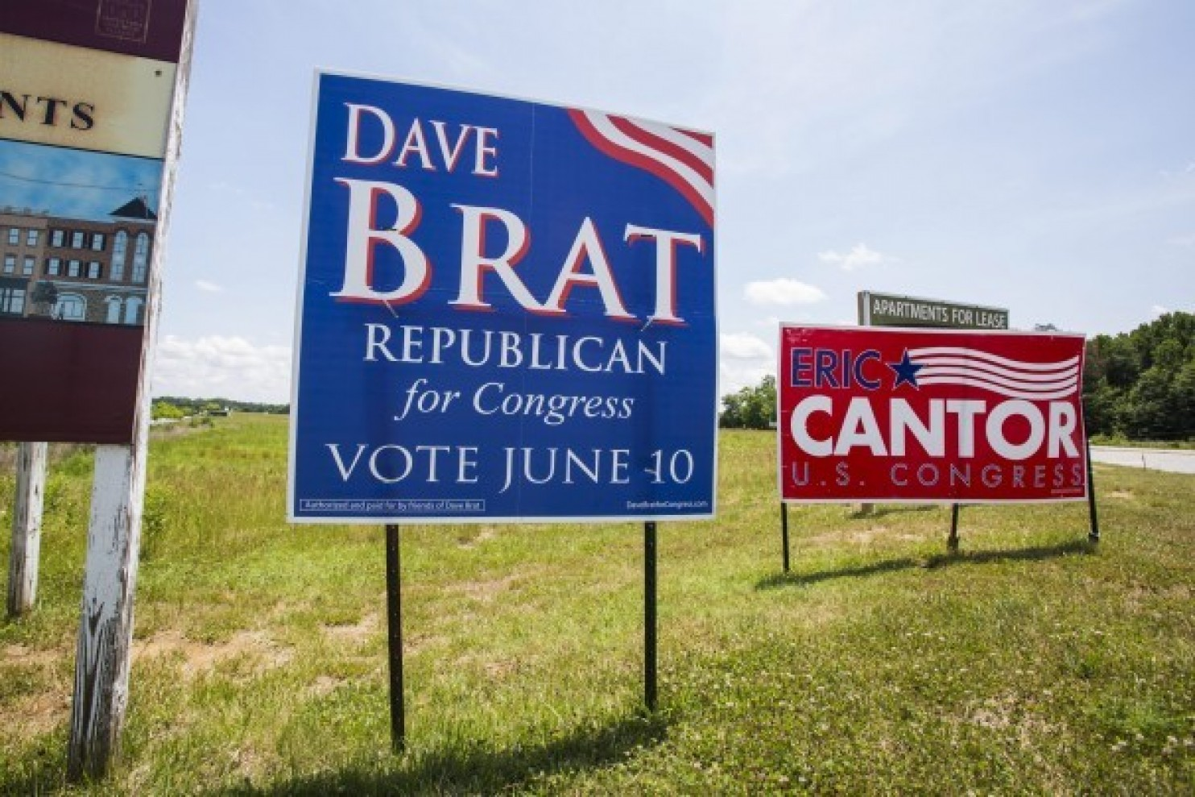
Congressional Elections
Most House elections concern local issues
Senate elections concern national and international issues.
Incumbent – the current seat holder running for reelection.
- possess huge advantages in elections.
- notoriety, staffing, fund raising, casework
- reelection rate is 96% in the House, slightly less in the Senate.

Slide 9

Gerrymandering
Reapportionment of the House
- Occurs after a census every 10 years
Redistricting
-Redrawing of districts to accommodate population shifts
Gerrymandering
- The corruption of redistricting to benefit an incumbent or political party

Slide 10

How do our Congressmen vote?
Influences:
Colleagues - logrolling
Congressional constituents
Ideology
Their party
Family/Friends
Religion
Special Interest Groups – Lobbyists

Slide 11
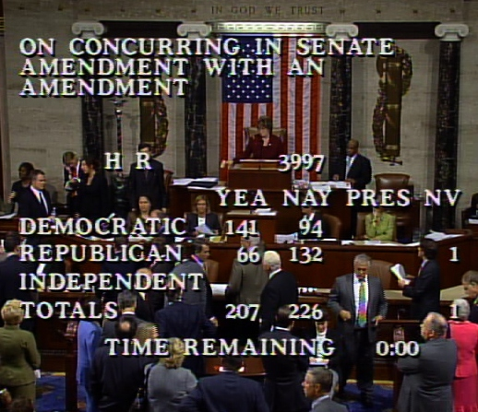
Voting Styles
Delegate – represent their constituents
Trustee – Vote their conscience
Partisan – vote based on the party’s position
Politicos – hybrid, consider all three

