Slide 1
Federalism Today
How Has the System Evolved?

Slide 2
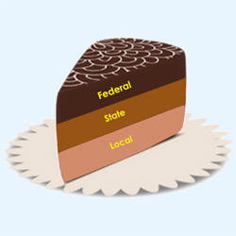
Dual Federalism
Original system envisioned by the Framers.
Federal and State governments each have distinct powers.
Layer Cake Federalism
Narrow interpretation of Federal power.

Slide 3
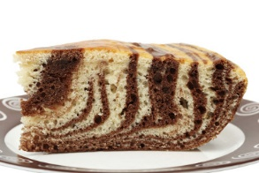
Cooperative Federalism
Result of expanding powers of Federal government.
Power is shared by State and Federal governments.
Marble Cake Federalism
Intergovernmental Relations
Examples: 9/11, Education

Slide 4
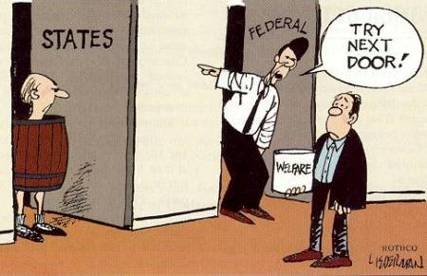
Key Components
Shared costs – federal government pays a portion, state and local pay a share.
Federal guidelines - strings attached to federal funds.
Shared administration – State and local governments enforce Federal policies. Create their own as well.
Fiscal Federalism - greatest power over the states is money.

Slide 5
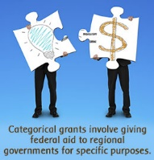
Federal Funds
Categorical grants –Federal funds for particular purposes. Carry stipulations.
project grants – granted on the basis of need.
formula grants – granted based on calculations per legislation or administrations.
Block grant – much more flexible. States have more discretion.

Slide 6
Mandates
Federal control of the States.
Requirements placed on the states in order to receive funding.
- Expansion of Medicare
Unfunded Mandate – requirements without financial assistance.
- Americans with Disabilities Act

