Slide 1
Federalism
How Power is Shared

Slide 2
Federalism is defined as…
Organizing a nation so that two or more levels of government have formal authority over the same area and people.
Shared power between units of government.

Slide 3
Types of Governments
Unitary
Confederate
Federal
All power resides within a central government.
Most common form of government in the world today.
An example is France.
Central government dictates the powers of the States or regional governments.
Citizens vote for central government positions.
All power belongs to sovereign States.
Common among international organizations.
Examples are the US under the AoC, CSA and the United Nations.
States dictate the duties of the weak central government.
Citizens vote for State positions.
Shared power between central and state governments.
Examples include US, Germany and Mexico. Only 11 nations today.
Both the central government and state governments have distinct powers and shared powers.
Citizens vote for leaders of both levels.

Slide 4
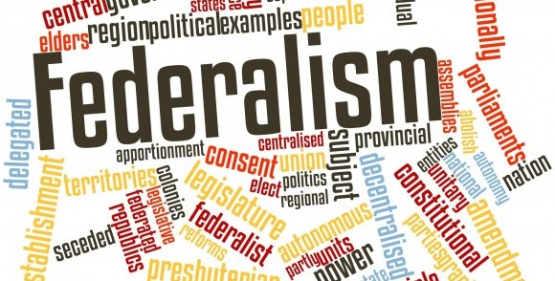
Why Federalism?
The Decentralization of Power

Slide 5
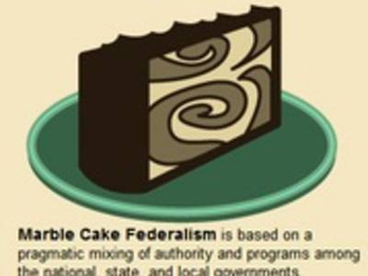
What Does it Achieve?
More layers of government
- more opportunity for participation
More leaders
- more points of access

Slide 6
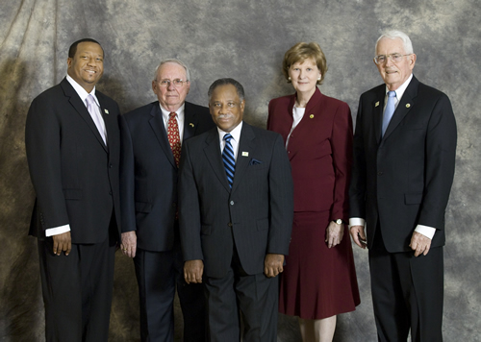
Improving Effectiveness
Localized decisions – lower a decision can be made, the less conflict between layers.
Enhances Judicial power – settle disputes between layers of government.

Slide 7
Constitution and The States
Framers emphasized their importance:
- given the power the States enjoyed under AoC, this was a necessity
- Equal representation in the Senate (unamendable per Article V!)
- Federal obligations: protect against violence and invasion
- 10th Amendment: “powers not delegated to the United States by the Constitution, not prohibited by it to the States, are reserved to the states respectively, or the people.”
Reserved certain powers, denied others.

Slide 8
State Obligations to Each Other
Full Faith and Credit – Article VI requires every state to:
- give full faith and credit to all public acts, records and court rulings of every other state.
- reciprocity
- drivers licenses, debts, offenses
Extradition – criminals surrendered to State where crime allegedly committed.
Privileges and Immunities – rights of citizenship regardless of State.
- prevents discrimination.

Slide 9
Evolution of Federal Power
- The Clauses
Supremacy Clause
Elastic Clause
Article VII of the Constitution.
Federal law trumps State law.
1. Constitution
2. Laws of the national government
3. Treaties – can only be made by the national government.
Congress is granted “enumerated powers” in Article I.
Granted “implied powers” by the “necessary and proper” clause.
- states that Congress may pass rules and laws which are necessary to carry out their enumerated powers.

Slide 10
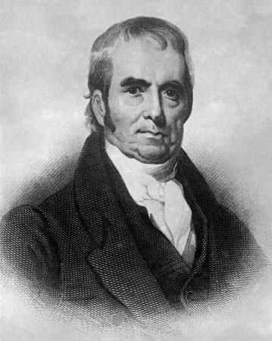
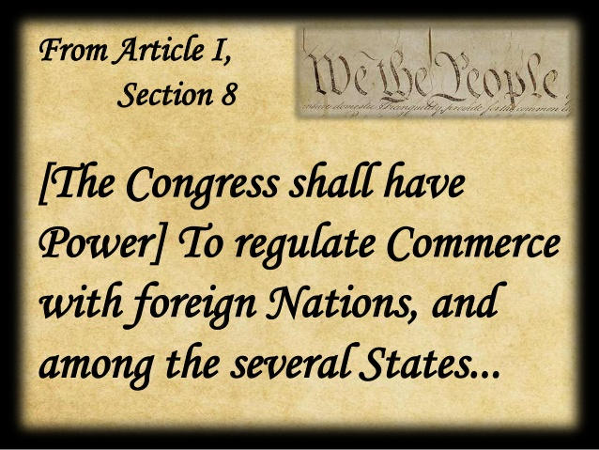
Evolution of Federal Power
- The Court Decisions
McCulloch v. Maryland
Gibbons v. Ogden

