Slide 1
Civil Liberties
The protection of individual rights

Slide 2
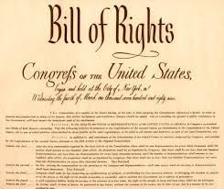
The Bill of Rights
First 10 Amendments to the U.S. Constitution.
Places restraints on the national government
Critical compromise between Federalists and Anti-Federalists.
Debate over the protection of these rights continues today.

Slide 3
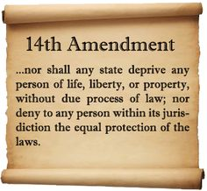
14th Amendment
Intended to place restraints on the States in terms of individual rights.
Two important aspects:
Equal protection clause – applied the Bill of Rights to all regardless of race.
Due process clause – life, liberty or property can only be denied by the courts.

Slide 4
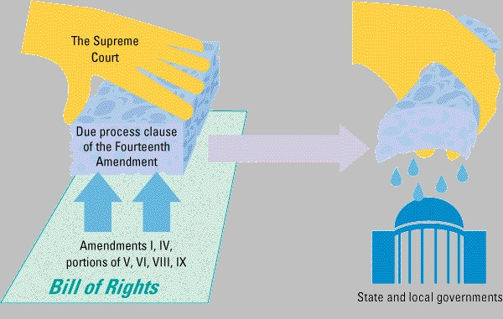
Incorporation Doctrine
The Supreme Court nationalized the Bill of Rights by applying it to the States through the 14th amendment.
Barron v. Baltimore(1833) – exempted States from the Bill of Rights.
Gitlow v. New York(1925) – incorporated the States and the 14th amendment.

Slide 5
Freedom of Religion
Two important elements:
Establishment Clause – “Congress can make no laws respecting the establishment of religion.”
One of the nation’s founding principles
- primary motivation for colonists
Lemon v. Kurtzman (1971)
- restricted federal aid to church related schools.
- strict uses of these funds by the recipient.

Slide 6
Freedom of Religion
Two important elements:
Free Exercise Clause – prohibits government from interfering with the practice of any religion.
Complicated Issue
- religions forbid actions society deems necessary.
- require actions that society finds unacceptable.
Examples:
multiple marriages, use of illegal drugs, military service

Slide 7
Freedom of Religion
Exceptions:
Courts allowed for Amish parents to withdraw children from school.
Conscientious objectors to war on religious grounds.
The Case of Muhammad Ali
- stripped of Heavyweight Title due to his refusal to serve in Vietnam.

Slide 8
Freedom of Expression
The right to say or publish what one believes.
Supreme Court Interpretations
Judicial Restraint
- Justice Hugo Black: “I read no law abridging to mean no law abridging.” Smith v. People
Judicial Activism
- Justice Oliver Wendell Homes: “The most stringent protection of free speech would not protect a person shouting ‘fire’ in a crowded theater causing a panic.” Schenck v. United States

Slide 9
Protected Speech?
A single commonality of all cases:
- does the expression receive protection of the constitution?
Prior Restraint
- a government’s actions that prevent material from being published
- censorship!
“Clear and Present Danger” rule
- not permitted when it threatens order and safety
- Dennis v. United States (1951)
- upheld convictions of Communist Party Leaders
- National Security supersedes the First Amendment

Slide 10
Protected Speech?
Free Press & Fair Trials
- a balancing act between the protection of free speech and the right to a fair trial.
- the Press has a right to access, but not to withhold evidence or impede.
- Shield Laws – laws passed in several States to protect a reporter’s sources.
Zurcher v. Stanford Daily
- ordered the paper to turn over photographs of violent protest.
Court Precautions
- press coverage of trials but not pre-trials
- sequester

Slide 11
Protected Speech?
Obscenity
Ruth v. United States
“Obscenity is not within the area of constituntionally protected speech or press.”
Miller v. California
Defined obscenity as:
- work, taken as a whole, appealed “to a prurient in sex.”
- “patently offensive” sexual conduct defined by obscenity law.
- lacked “serious literacy, artisitic, political or scientific value.”

Slide 12
Protected Speech?
Libel and Slander
Libel – publication of false or malicious statements that damage someone’s reputation.
Slander – spoken defamation.
These have proven very difficult to prove in court.
- often the threat of litigation is sufficient.
Examples
- General Westmoreland
- Jerry Falwell

Slide 13
Protected Speech?
Symbolic Speech
-actions that do not consists of writing or speech but convey an opinion.
- wearing an arm band, flag burning, marching in a parade.
Freedom of Assembly
- parade, picket and protest
- must not conflict with public order, traffic flow, peace and quiet, and bystander safety.

Slide 14
Defendants’ Rights
Probable cause – reasonable grounds that someone is guilty of a crime.
Search warrant – written authorization from a court citing:
1. what will be searched
2. what is being looked for
Exclusionary rule – Evidence obtained through unreasonable searches & seizures are inadmissible in court.
- established in Mapp v. Ohio (Mapp rule)

Slide 15
Defendants’ Rights
Self-Incrimination – 5th Amendment
- no person shall be compelled to be a witness against himself.
Miranda rights
- established by Miranda v. Arizona
1. right to remain silent.
2. anything said can and will be used against them in court of law
3. right to have a lawyer present during questioning.
4. court will provide an attorney if they cannot afford one.

Slide 16
Defendants’ Rights
Right to Council – 6th Amendment
- expanded by Gideon v. Wainwright
- anyone accused of a felony which carries imprisonment has the right to a lawyer.
Cruel & Unusual Punishment – 8th Amendment
- death penalty ruled cruel and unusual for certain offenses
- not ruled cruel and unusual itself.
- remains a heavily debated issue today

Slide 17
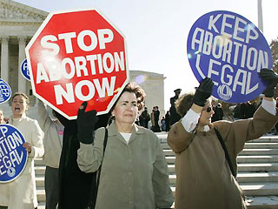
4th Amendment
Right to Privacy
- relates back to defendants rights in terms of searches and siezures.
- right to a personal life free from the intrusion of government.
Roe v. Wade
- Supreme Court decision on abortion was based on the Right to Privacy.

