Slide 1


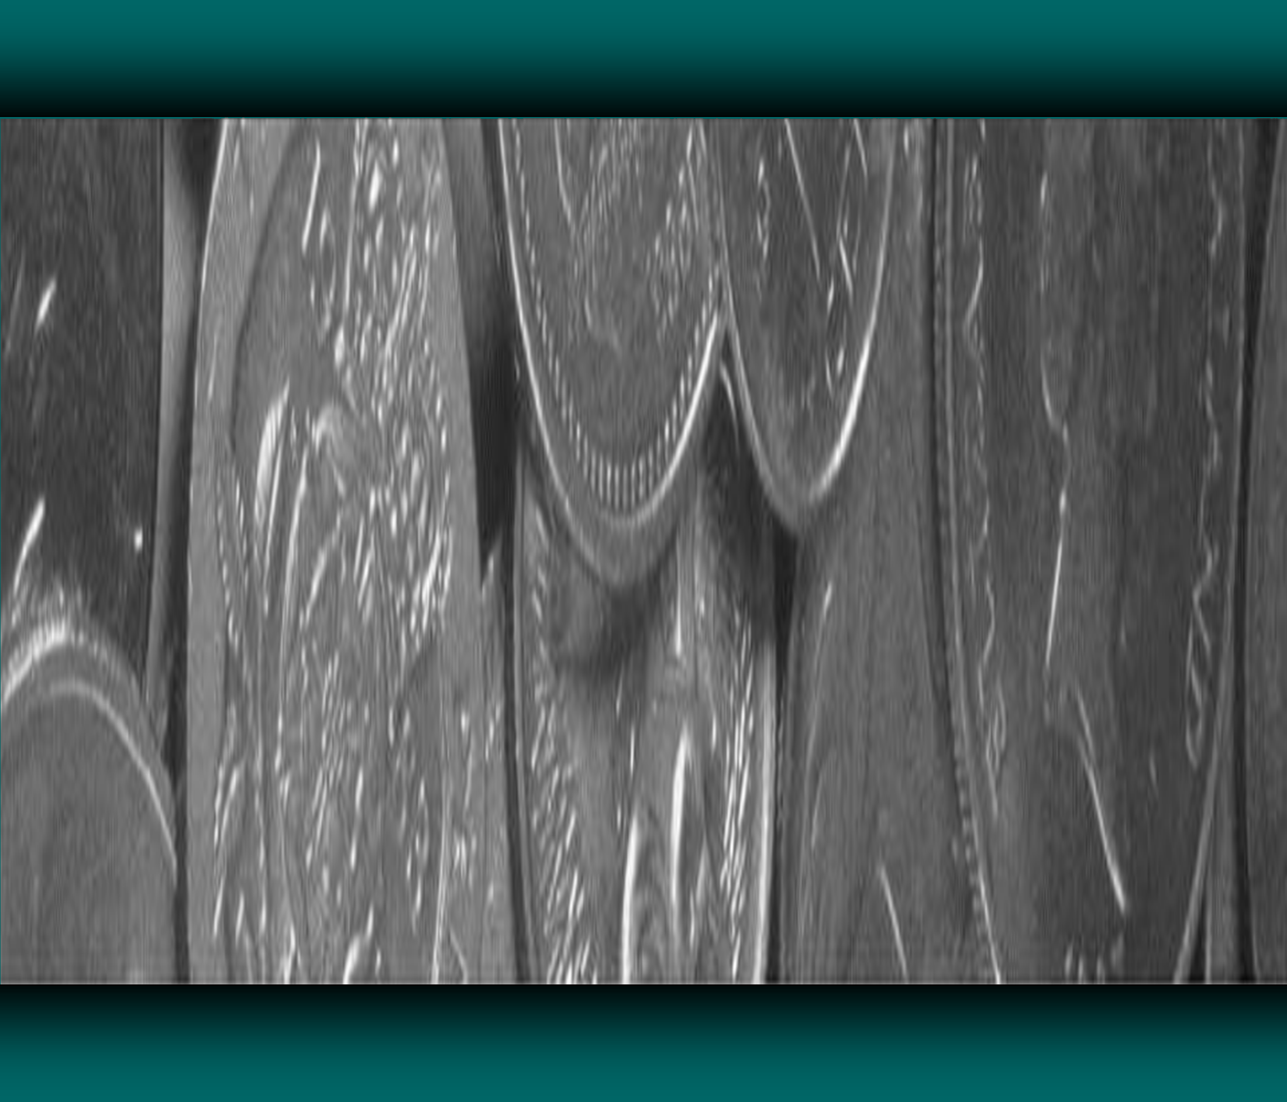

VUS.8b
What fuele
d the modern industrial
economy?

Slide 2
During the period from the Civil War to World War I, the United States underwent an economic transformation that involved a developing industrial economy, the expansion of big business, the growth of large-scale agriculture, and the rise of national labor
unions and industrial conflict

Slide 3
Technological change spurred growth of industry primarily in northern cities.

Slide 4
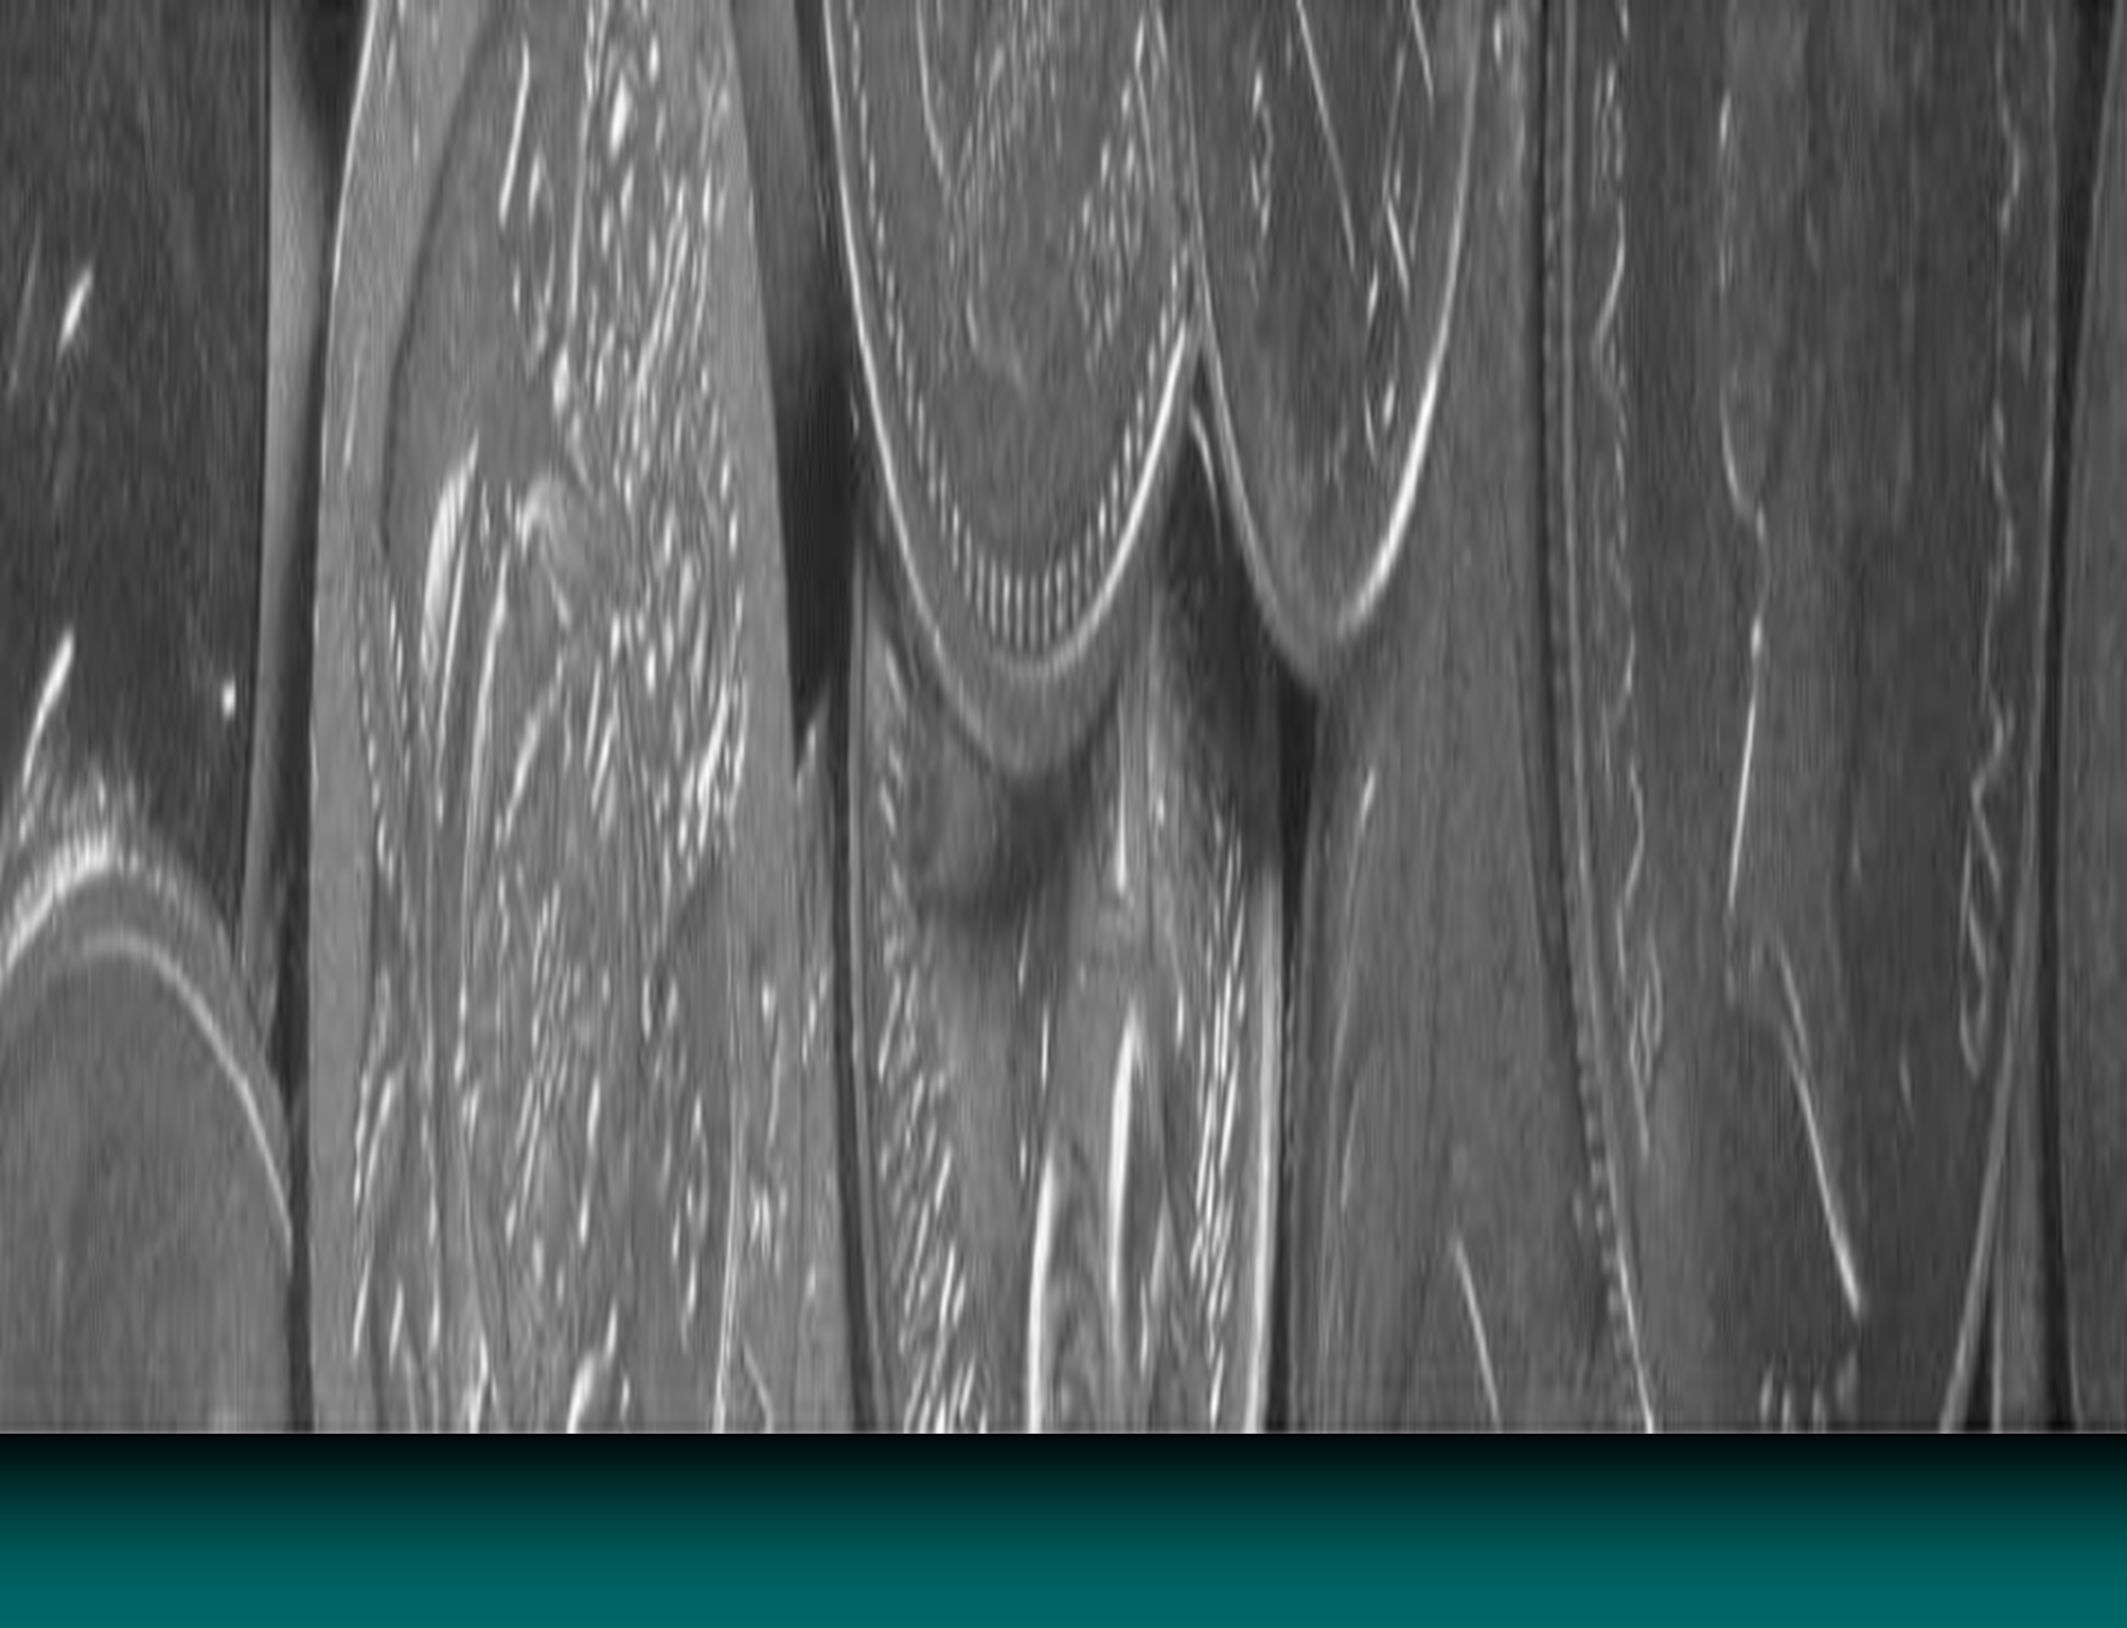

Inventions/Innovations:
Corporation
Investors would buy stock in companies, then earn dividends when profits were made
This would give the corporation capital with which to operate and expand.
Investors could only lose the amount of money they put into the company (limited
liability)

Slide 5

Inventions/Innovations:
Bessemer steel process
This was a quicker and cheaper way to make steel.
Railroads were the largest users of steel by the end of the 19th century.
Steel was a primary resource used for America’s
industrialization!

Slide 6



Inventions/Innovations:
Light bulb/ electricity
Both developed by
Thomas Edison
Electricity as a source of power and light allowed for American lives to change at work and at play.
Edison founded the first electric company.

Slide 7


Inventions/Innovations:
Telephone
Invented by Alexander Graham Bell
This improved communication.
This even helped women to find work as switchboard operators- a much better job than a factory worker!

Slide 8

Inventions/Innovations:
Airplane
Invented by the
Wright Brothers
First flight at Kitty Hawk, 1904
The use of planes has grown considerably over the last century!

Slide 9

Inventions/Innovations:
Assembly line manufacturing
Innovation by Henry Ford as a way to make his automobile more cheaply.
He increased production by moving the product along an electric conveyor belt!
Ford boasted that consumers could even get the Model T in any color they wanted, as long as it was black. His assembly line made autos affordable for the average family.

Slide 10
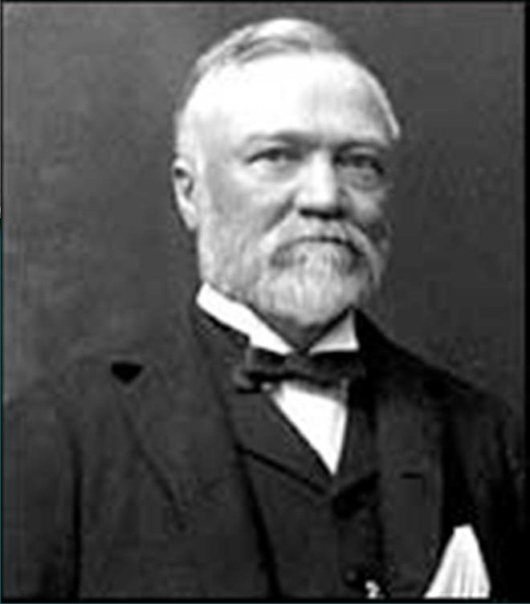

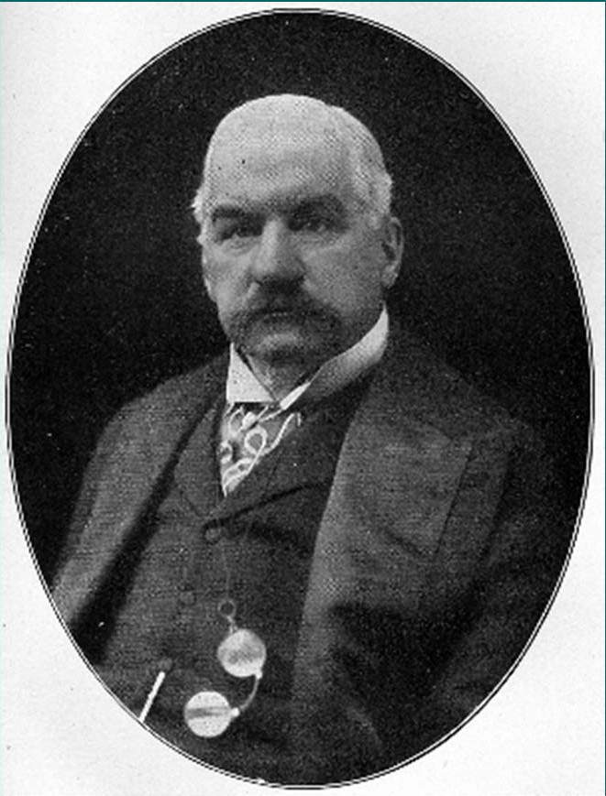
Andrew Carnegie (steel); a true
immigrant to riches story, he made his fortune reducing the cost of producing steel. Later in life, Carnegie became a respected philanthropist- believing the wealthy should
“give back” to the community.
J.P. Morgan (finance); earned his first wealth in banking business, then later created US Steel Corporation whey he bought Carnegie’s company.

Slide 11
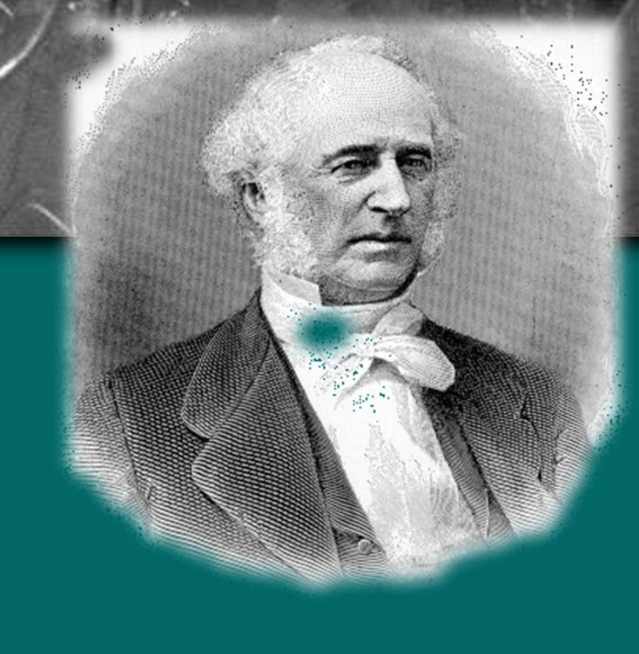

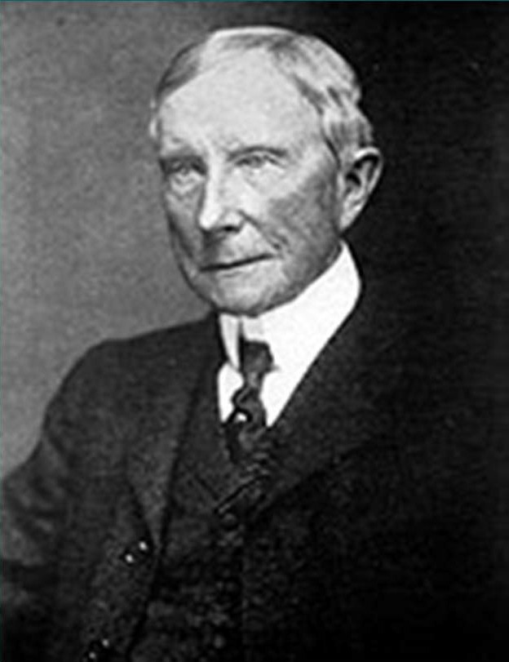
Cornelius Vanderbilt (railroads); became a
tycoon as he acquired vast amounts of railroad tracks and forced smaller companies out of business by charging lower fares in areas of
competition.
John D. Rockefeller (oil); created the Standard Oil Company and increased wealth through vertical integration of resources as well as advertising. Like Carnegie, he became a respected philanthropist.

Slide 12
Reasons for economic transformation
Government policies of laissez-faire (“hands-off”) capitalism and special considerations (e.g., land grants to railroad builders)
The increasing labor supply (from immigration and migration from farms) in the cities
America’s possession of a wealth of natural resources and navigable rivers

Slide 13
During the period from the Civil War to World War I, the United States underwent an economic transformation that involved a developing industrial economy, the expansion of big business, the growth of large-scale agriculture, and the rise of national labor
unions and industrial conflict

