Slide 1



VUS.12a-b
MOBILIZING FOR WAR
➢How did the United States organize and distribute its resources to achieve victory during World War II?
➢How did women and minorities contribute to America’s efforts during World War II?

Slide 2
SUCCESS IN THE WAR REQUIRED THE TOTAL COMMITMENT OF THE NATION’S RESOURCES. ON THE HOME FRONT, PUBLIC EDUCATION AND THE MASS MEDIA PROMOTED NATIONALISM.

Slide 3
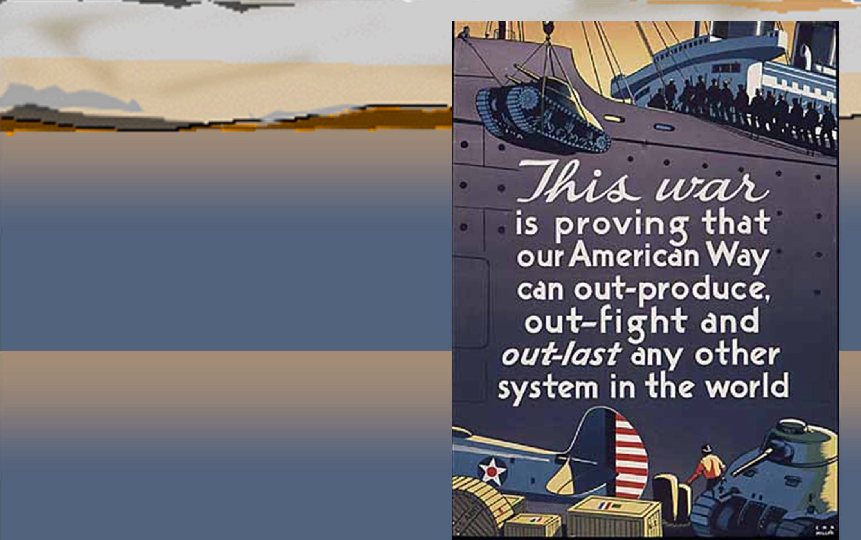
ECONOMIC RESOURCES
U.S. government and industry forged a close working relationship to allocate resources effectively.

Slide 4
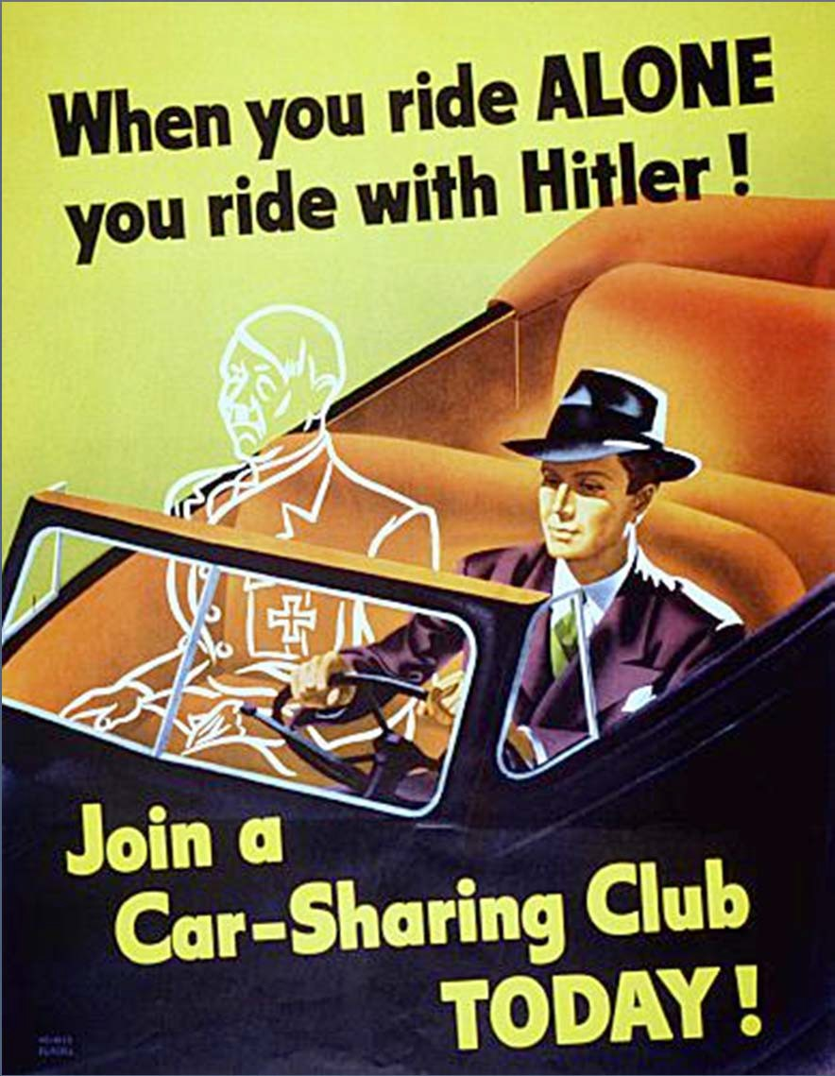
RATIONING:
Fixed allotments of goods to be consumed at home
Used to maintain supply of essential products for war.
Included rubber, fuel, silk, and food
People saw this as a way to help in the war effort!
Posters such as this advocated conservation.

Slide 5
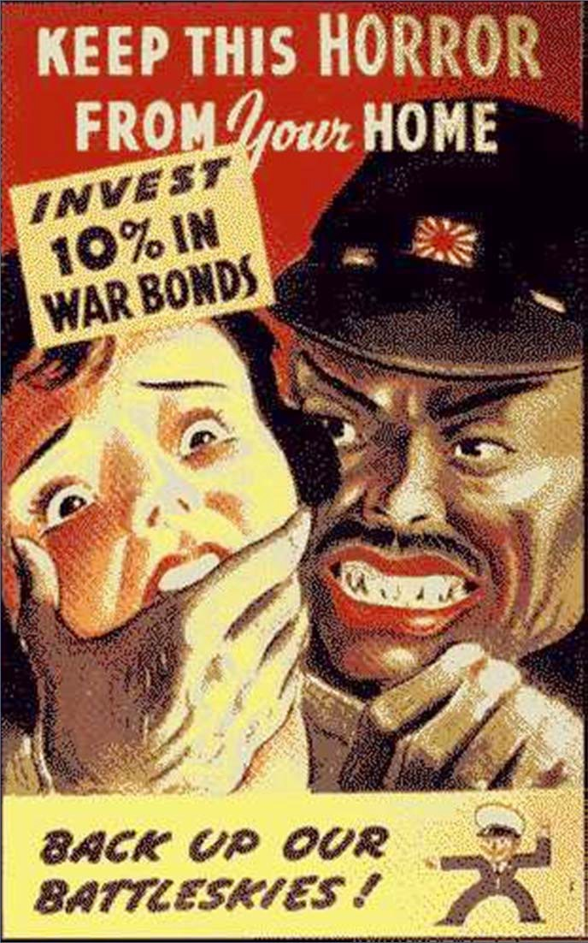
HOW TO PAY FOR THE
EFFORT?
Income taxes were increased drastically.
War bonds were sold.
Americans took pride in buying bonds to assist the effort.
Celebrities were used to help sell war bonds.
Posters such as this encouraged Americans to buy war bonds.

Slide 6
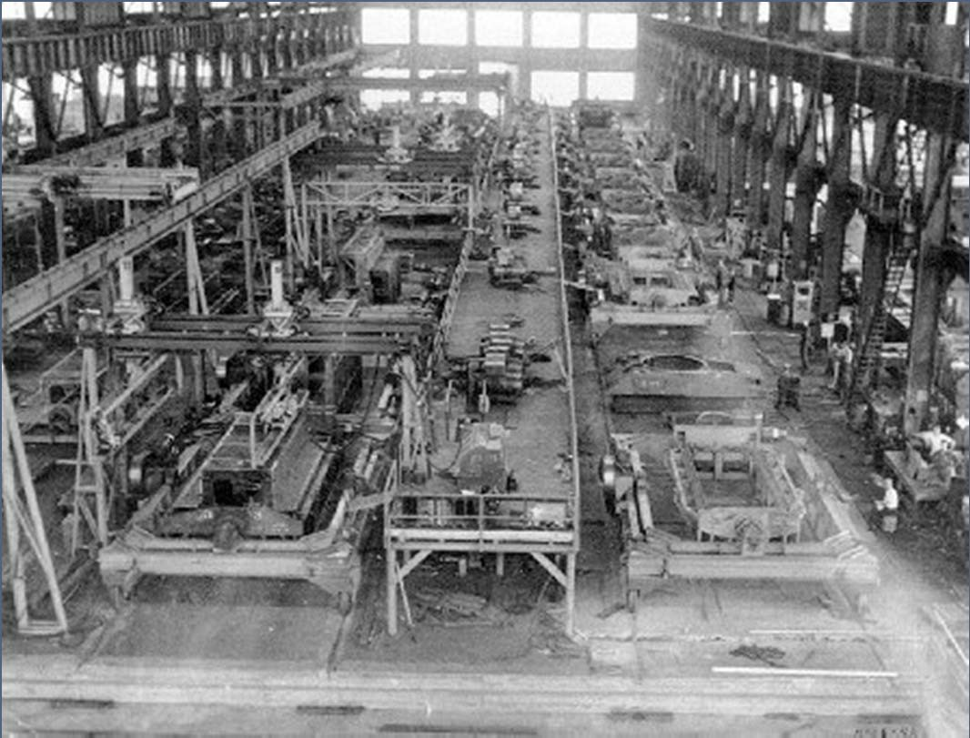
BUSINESS
RETOOLED:
Business quickly converted from peace- time to war-time production.
There was a high demand for production.
Human resources needed to be managed as well.
This factory retooled from making automobiles to tanks for the Allied cause. We needed build faster than they could be destroyed! (National Archives Photo)

Slide 7


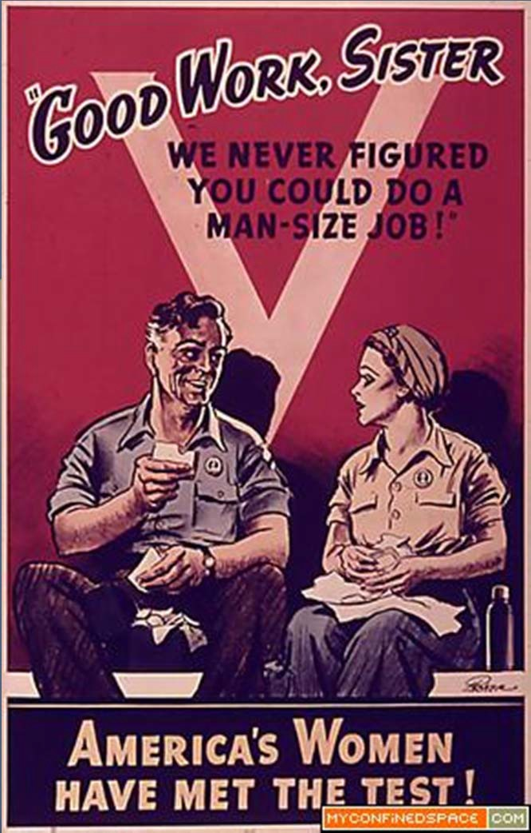
HUMAN RESOURCES
The American people were perhaps the greatest resource which allowed for Allied victory in World War 2.

Slide 8
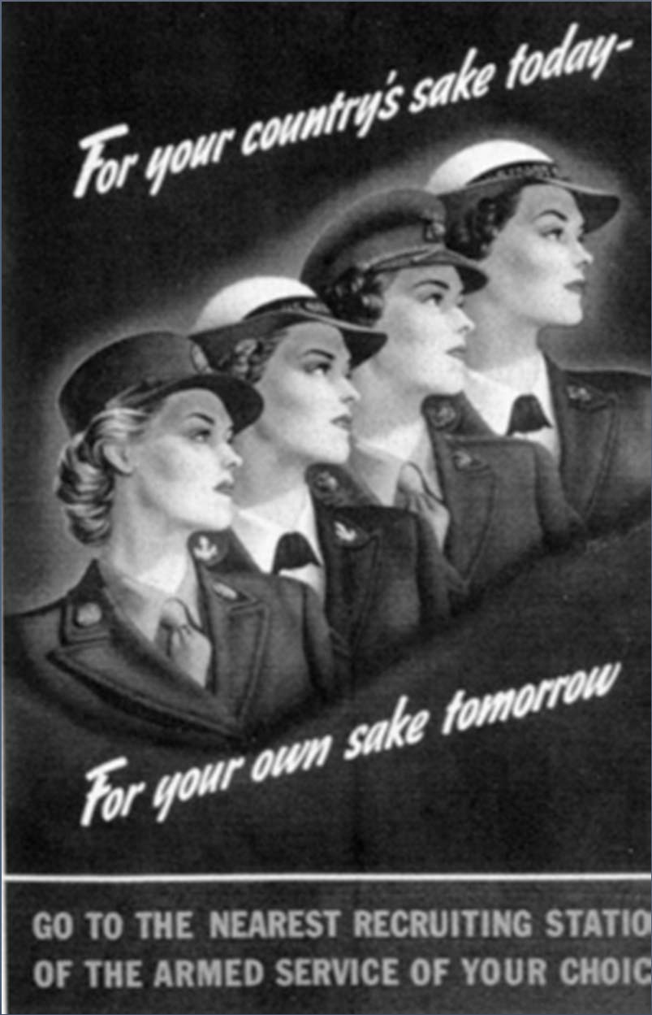
BUILDING THE ARMY:
The selective service was used to draft the needed men.
Women also joined the armed forces
Women typically participated in non- combat military roles.

Slide 9
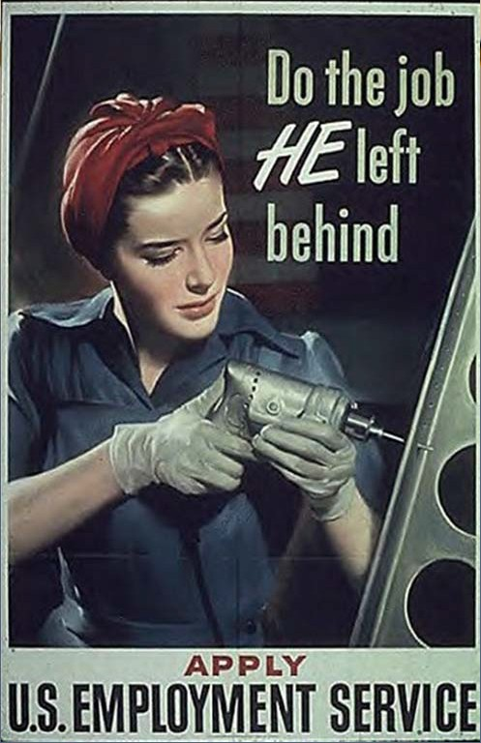
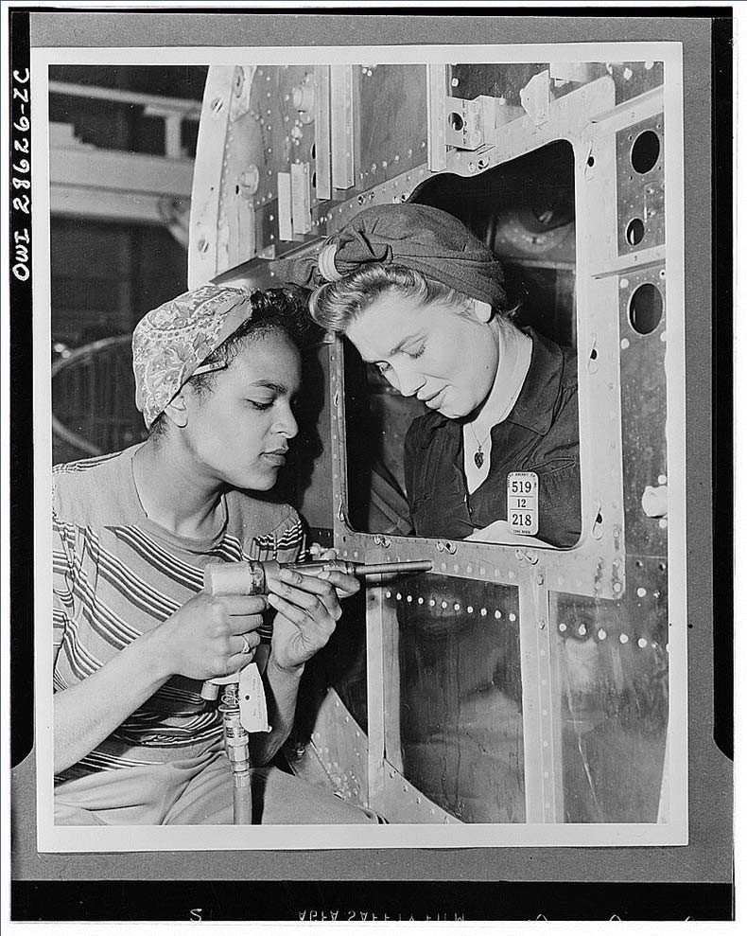
CONTRIBUTIONS TO THE WAR EFFORT CAME FROM ALL SEGMENTS OF SOCIETY.
WOMEN ENTERED INTO PREVIOUSLY MALE JOB ROLES AS AFRICAN-AMERICANS AND OTHERS STRUGGLED TO OBTAIN DESEGREGATION OF THE ARMED FORCES AND END DISCRIMINATORY HIRING PRACTICES!

Slide 10
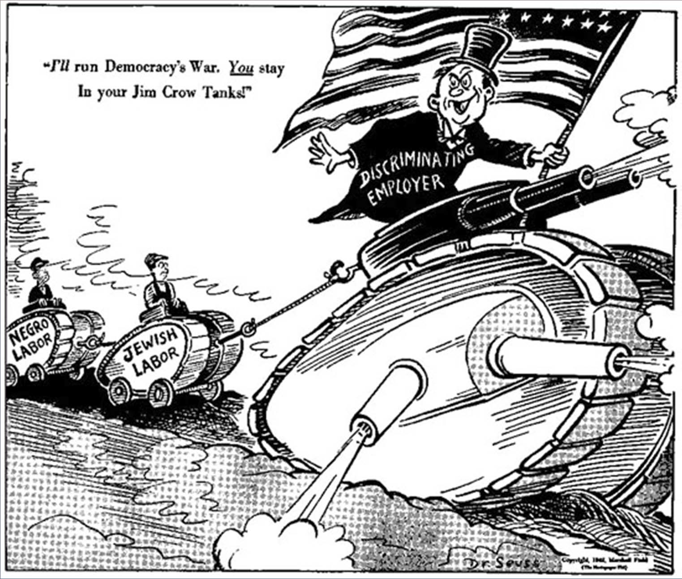
This cartoon from Seuss expresses his frustration with discrimination in the War Industry (1942).

Slide 11
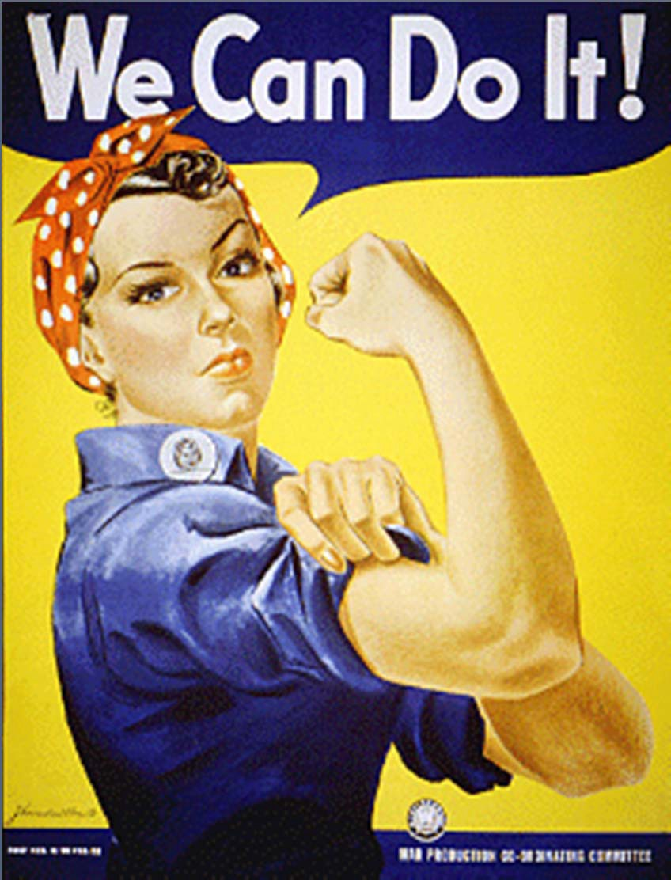
WOMEN:
Women increasingly participated in the workforce.
Women now did jobs previously reserved for men.
“Rosie the Riveter” was the symbol of this movement!
This is one image of “Rosie the Riveter”.

Slide 12
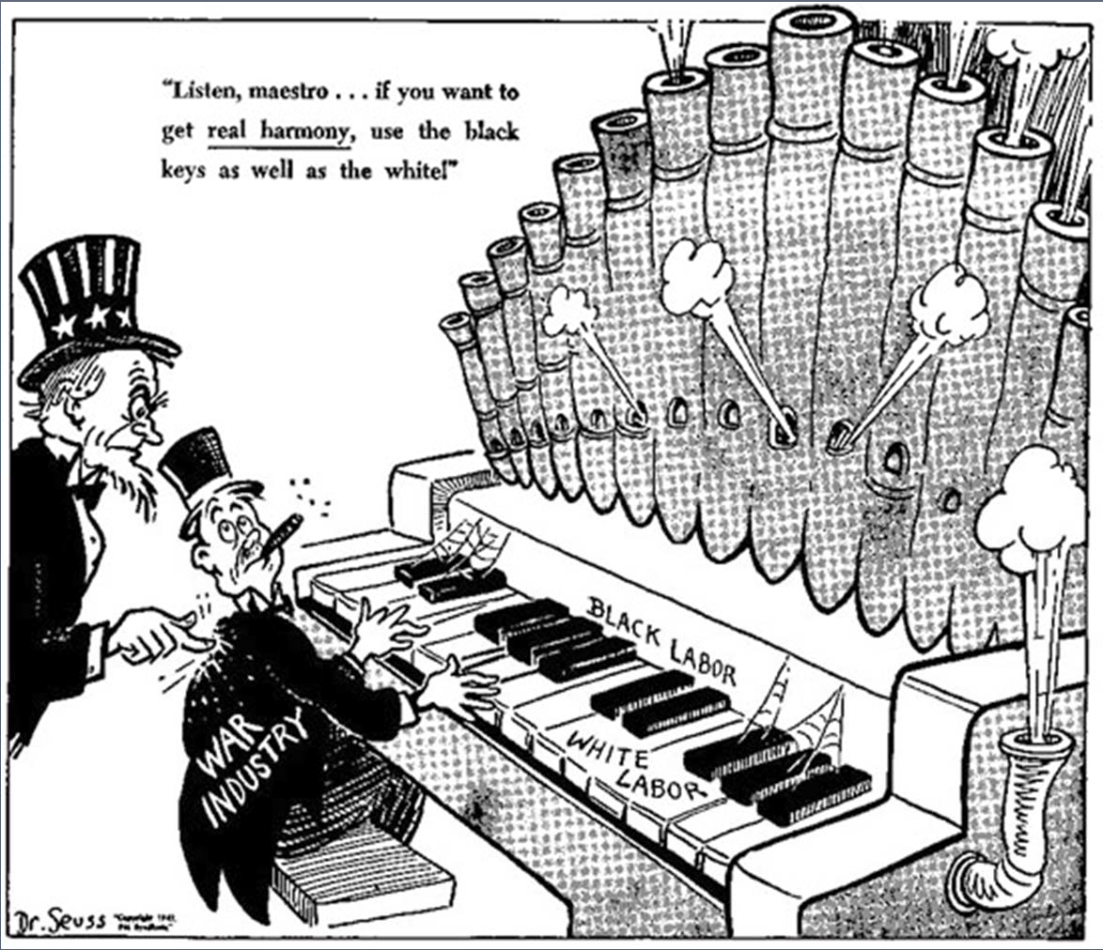
AFRICAN- AMERICANS:
Migrated to cities in search of jobs (another surge of the Great Migration)
They were subjected to discrimination and segregation in the workforce.
Campaigned for victory in war and equality at home.
FDR finally banned discrimination in all war factories.
“Listen, maestro…If you want to get real harmony, use the black keys as well as the white!”
A Dr. Seuss Cartoon from1942

Slide 13
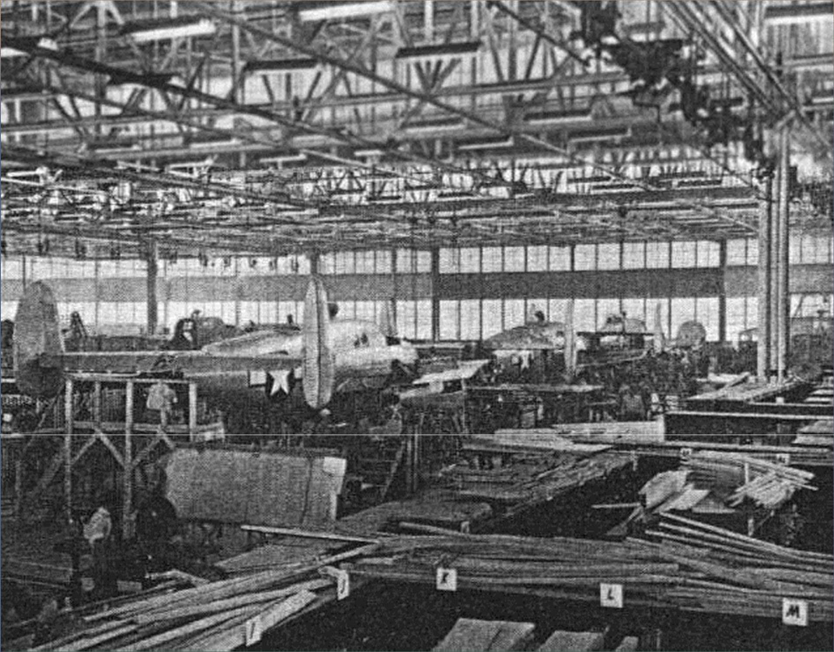
THE U.S. GOVERNMENT BECAME THE LARGEST CONSUMER OF AMERICAN BUSINESS!

