Slide 1



VUS.13b
Flags courtesy of www.theodora.com/flags used with permission

Slide 2
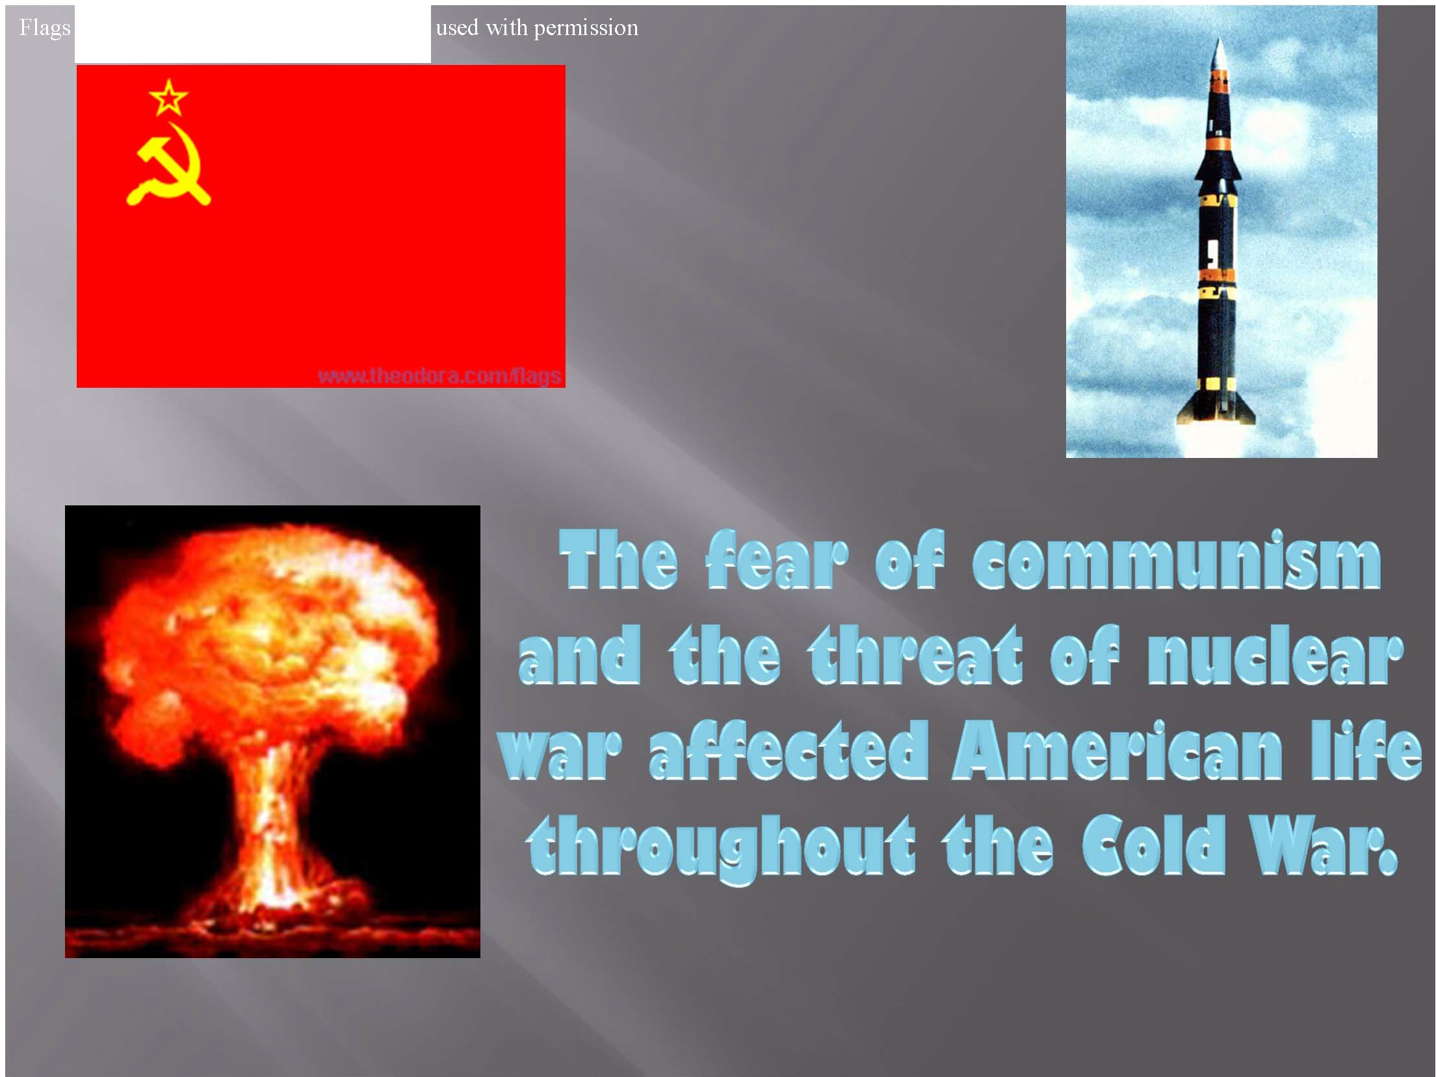
courtesy ofi \v.ww.theodora .corn!flags

Slide 3
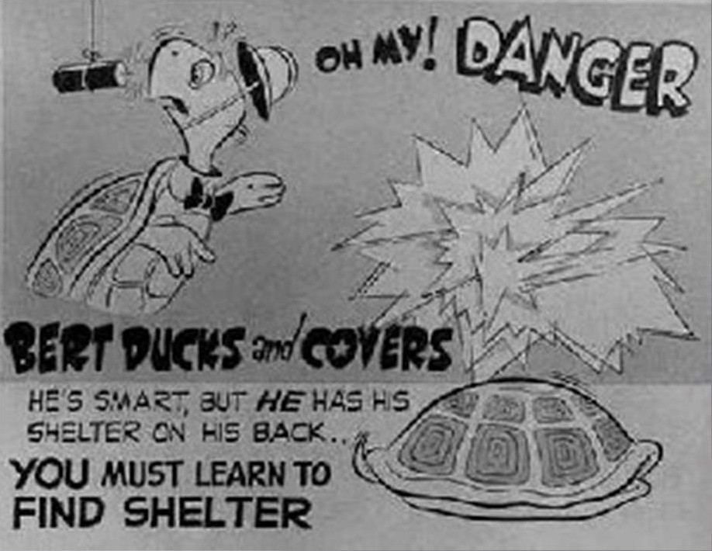
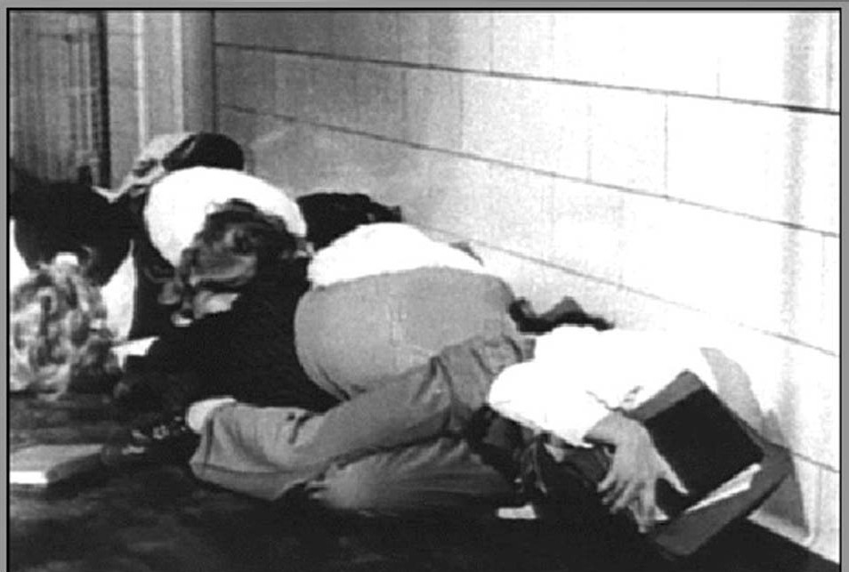
During the 1950s and 1960s, American schools regularly held drills to train children what to do in case of a nuclear attack.
“Bert the Turtle” taught Americans to avoid being killed in a nuclear attack by ducking and covering…
These notions, though idiotic today, allowed people to feel they had some control over their situation.

Slide 4
American citizens were urged by the government to build bomb shelters in their own basements.
People could live in a bomb shelter like this for
several months after an attack…
This was their “safe place” in case of a nuclear attack.

Slide 5

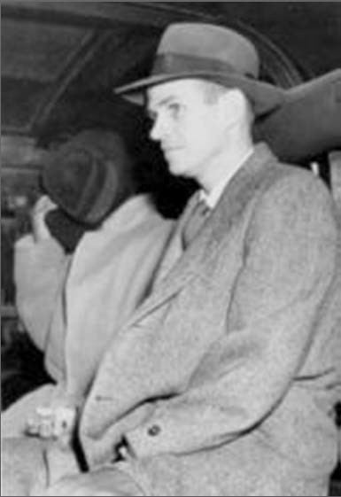
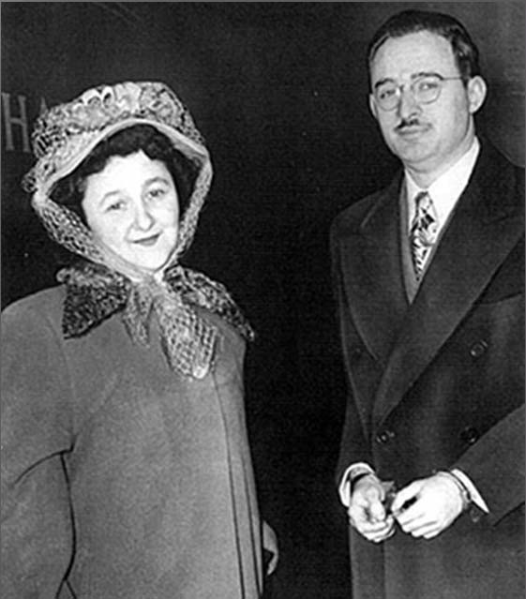
The convictions of Alger Hiss, and
Julius and Ethel Rosenberg for spying for the Soviet Union, and the construction of nuclear weapons by the Soviets using technical secrets obtained through spying heightened our fears!
Alger Hiss (above) was convicted of espionage in the State Department. Julius and Ethel Rosenberg (below) were convicted of selling atomic secrets to the Soviets. They were put to death!

Slide 6

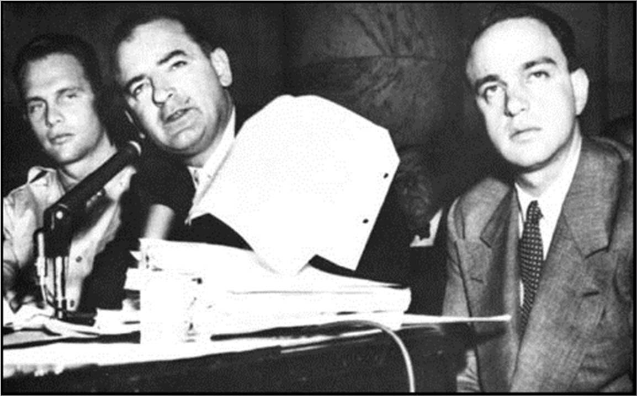

Senator Joseph McCarthy played on American fears of communism by recklessly accusing many American governmental officials and citizens of being communists based on flimsy or no evidence.

Slide 7
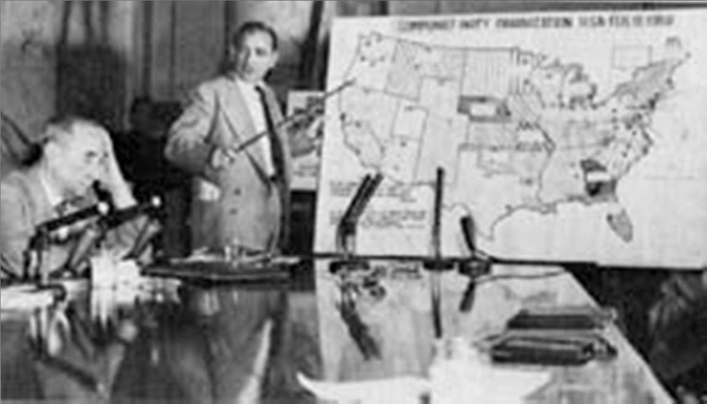
The hunt for communists led to the coining of the term McCarthyism-- the making of false
McCarthy, the feared “red” (communist) hunter, displaying the "distribution"
_{accusations based on rumor}of communists in different
states. He was known for his phrase “I have a list of known communists”. No one ever saw “the list”.
or guilt by association.

Slide 8
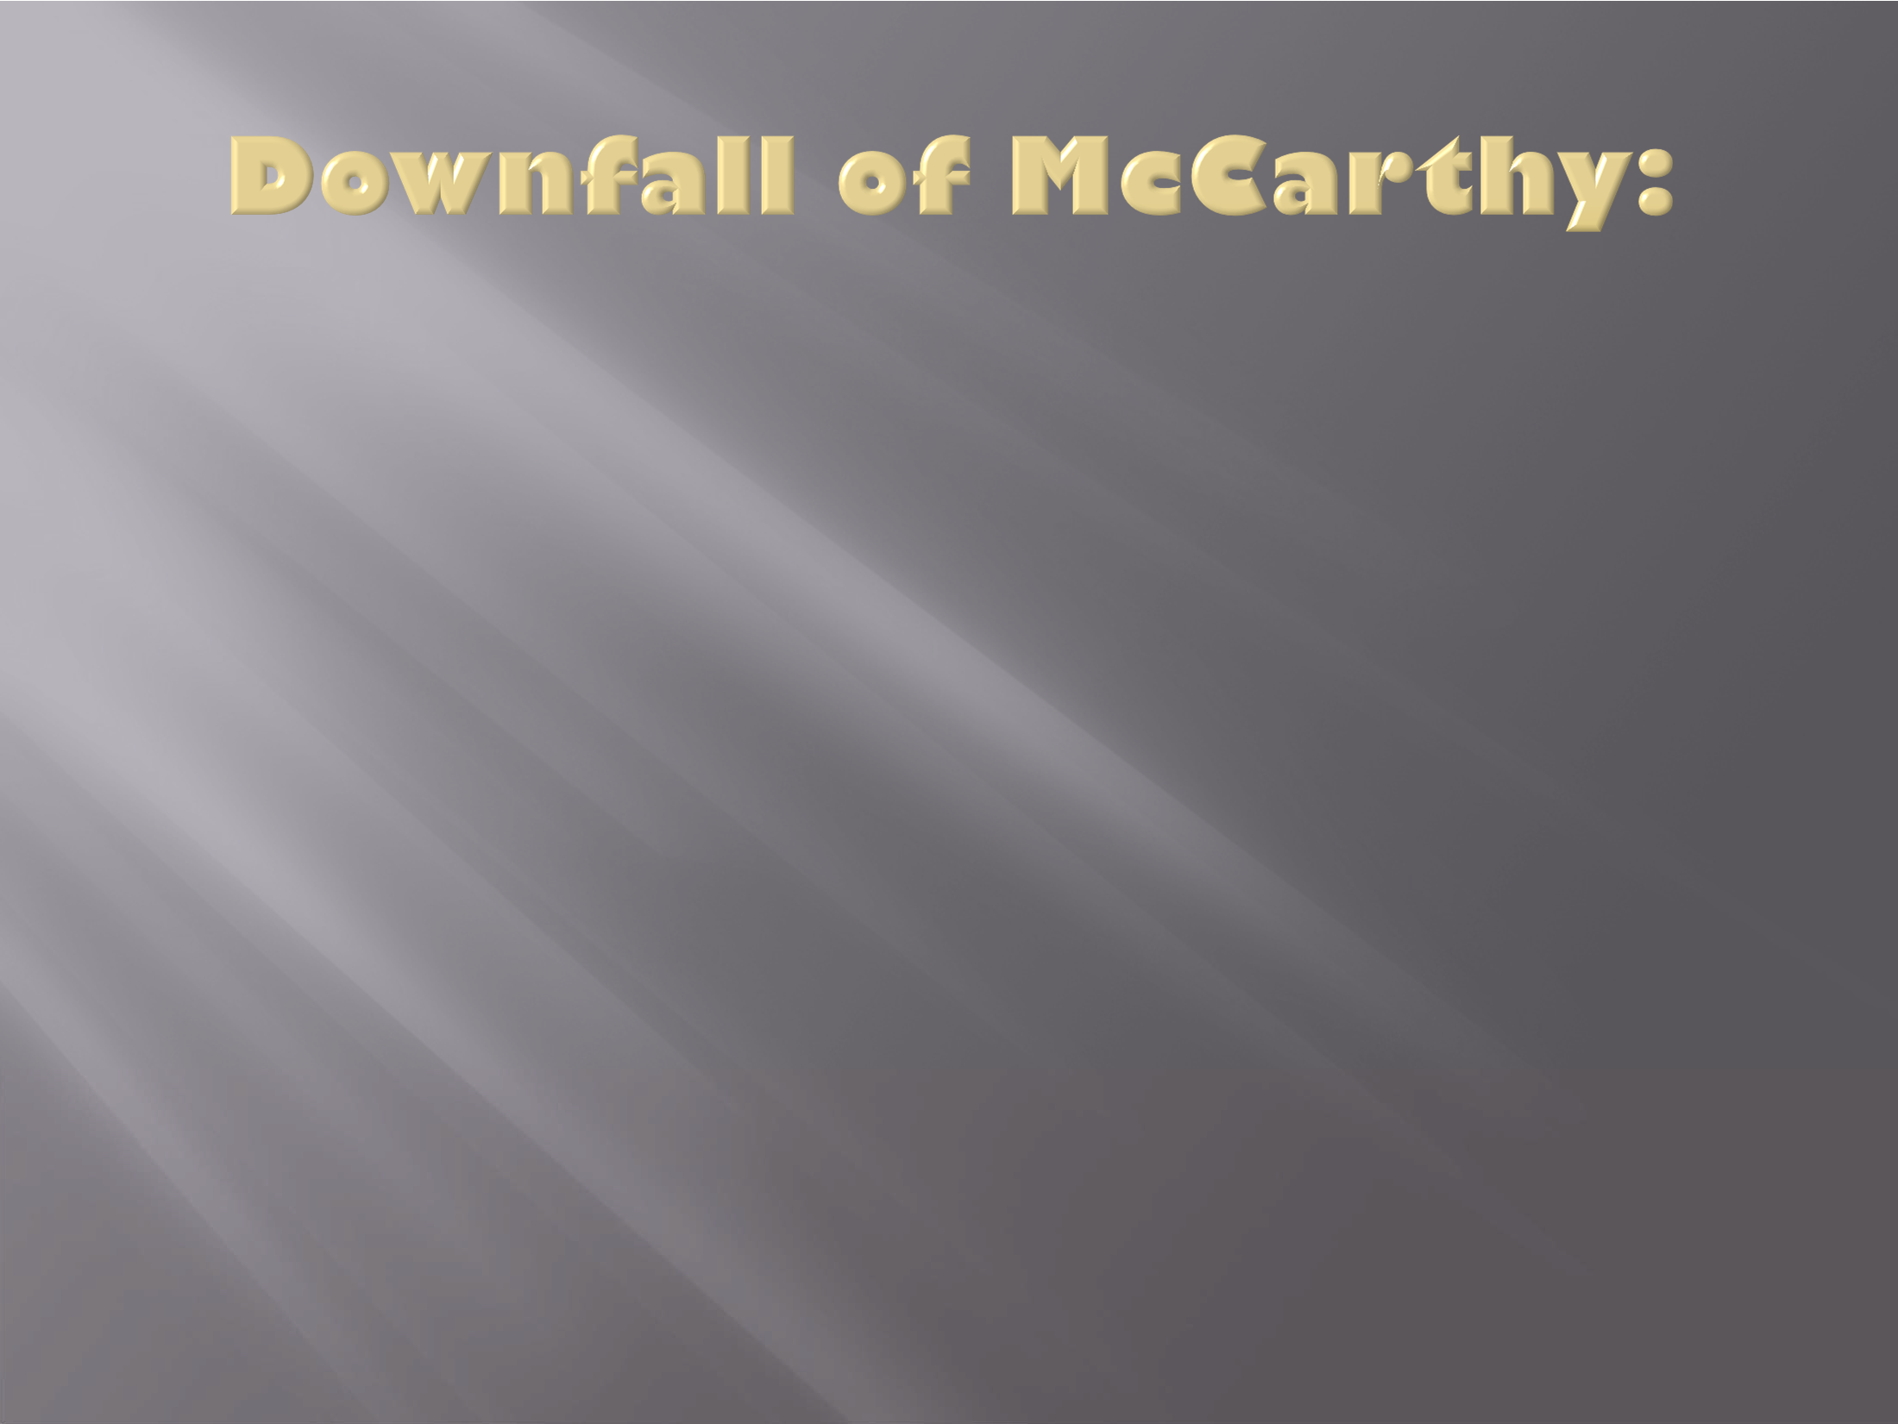
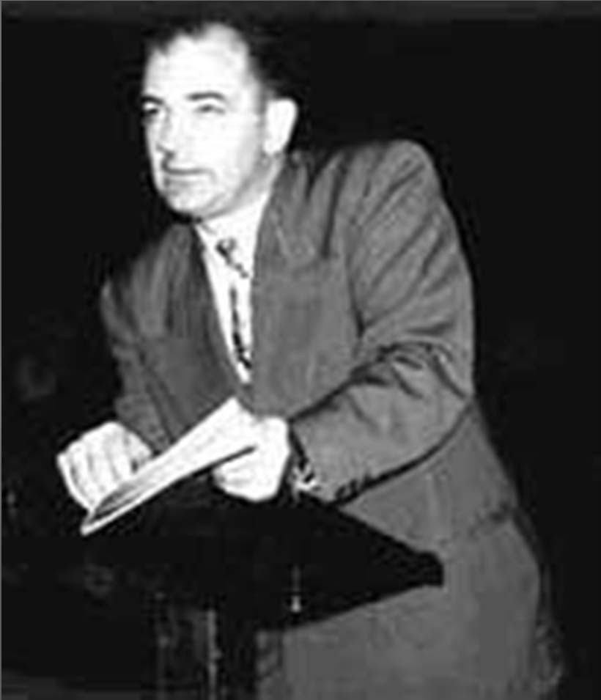
Senator Joe McCarthy became a very powerful man. Those who criticized him were labeled as “soft on communism”.
He seemed to self-destruct as TV cameras showed the nation his “bully tactics”.
He was not re-elected and left office in relative obscurity.

Slide 9
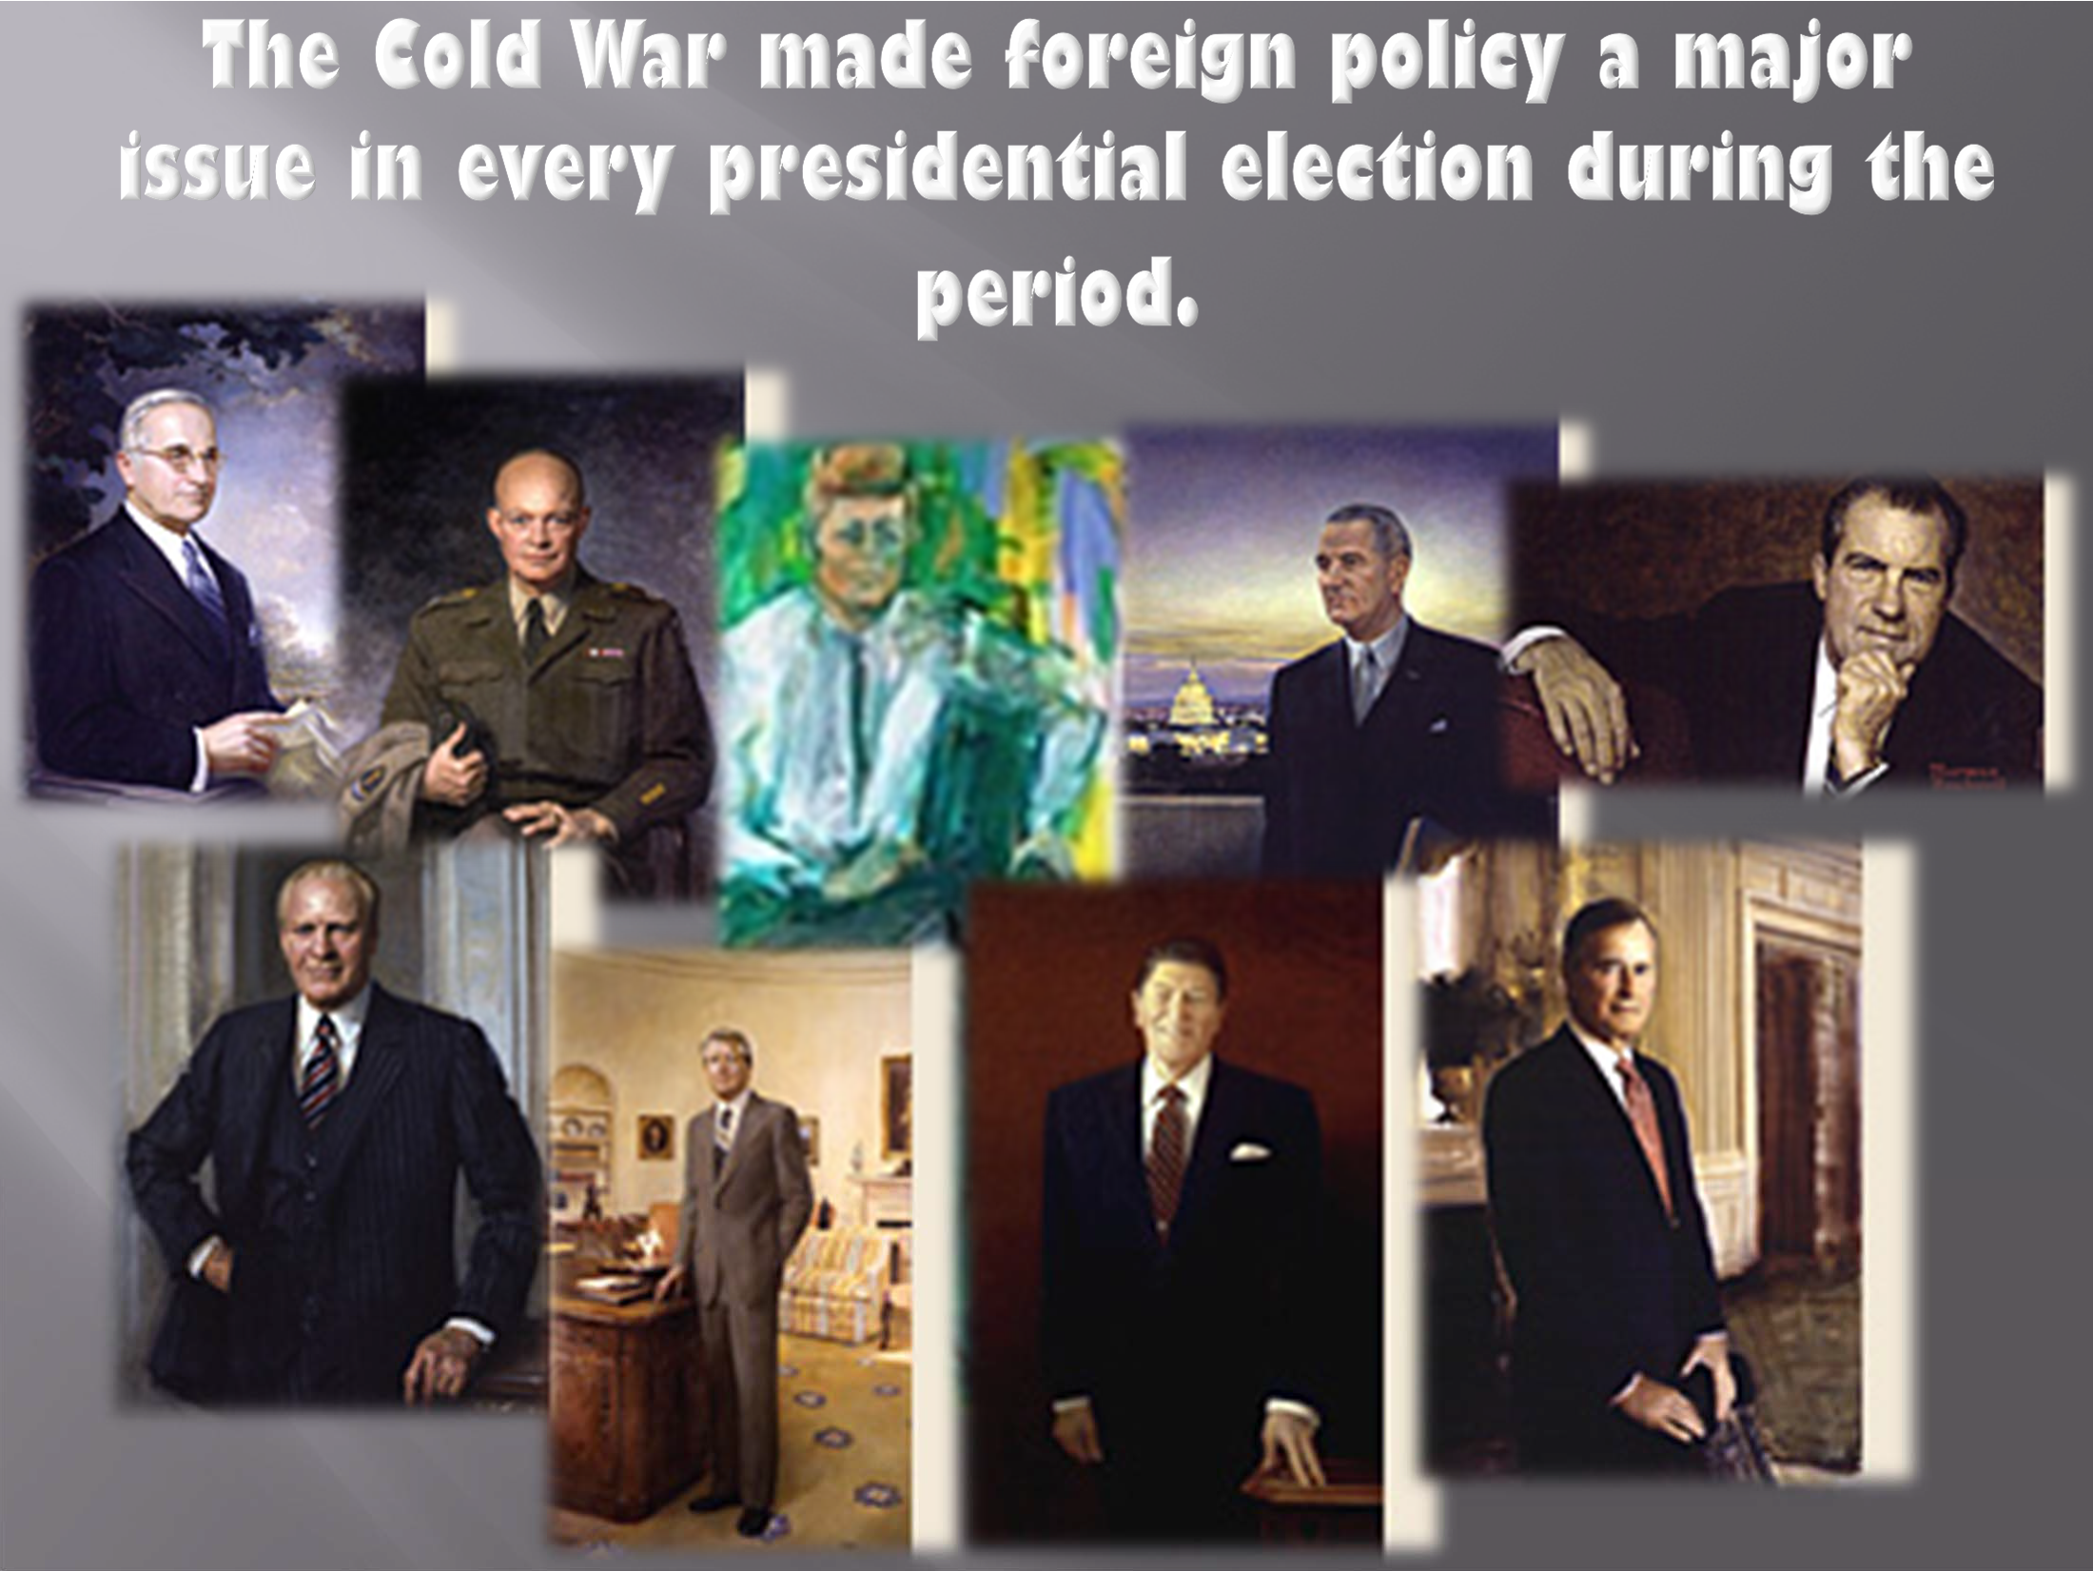
Portraits courtesy of National Portrait Gallery, Smithsonian Institution

Slide 10
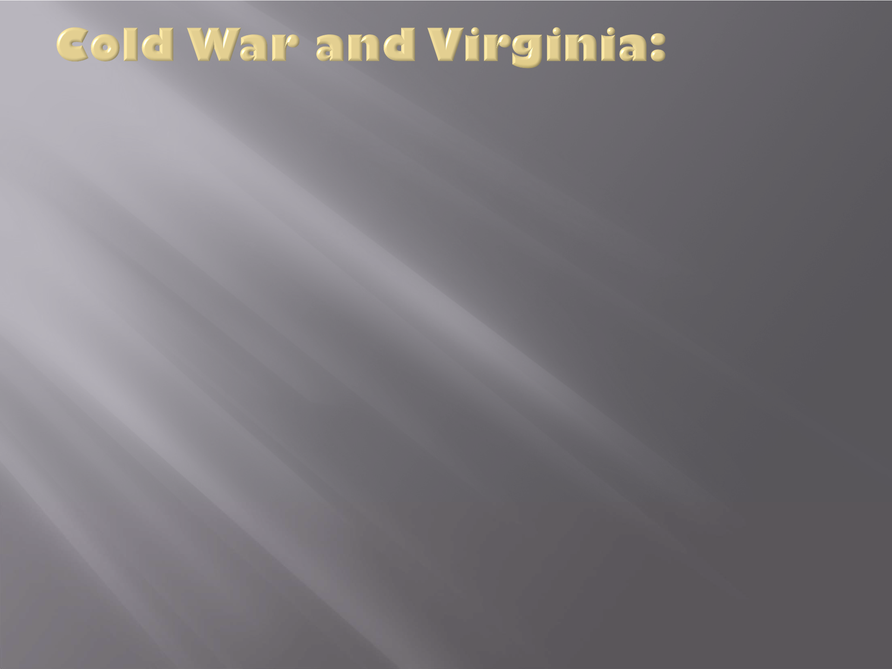
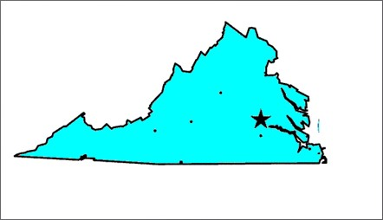
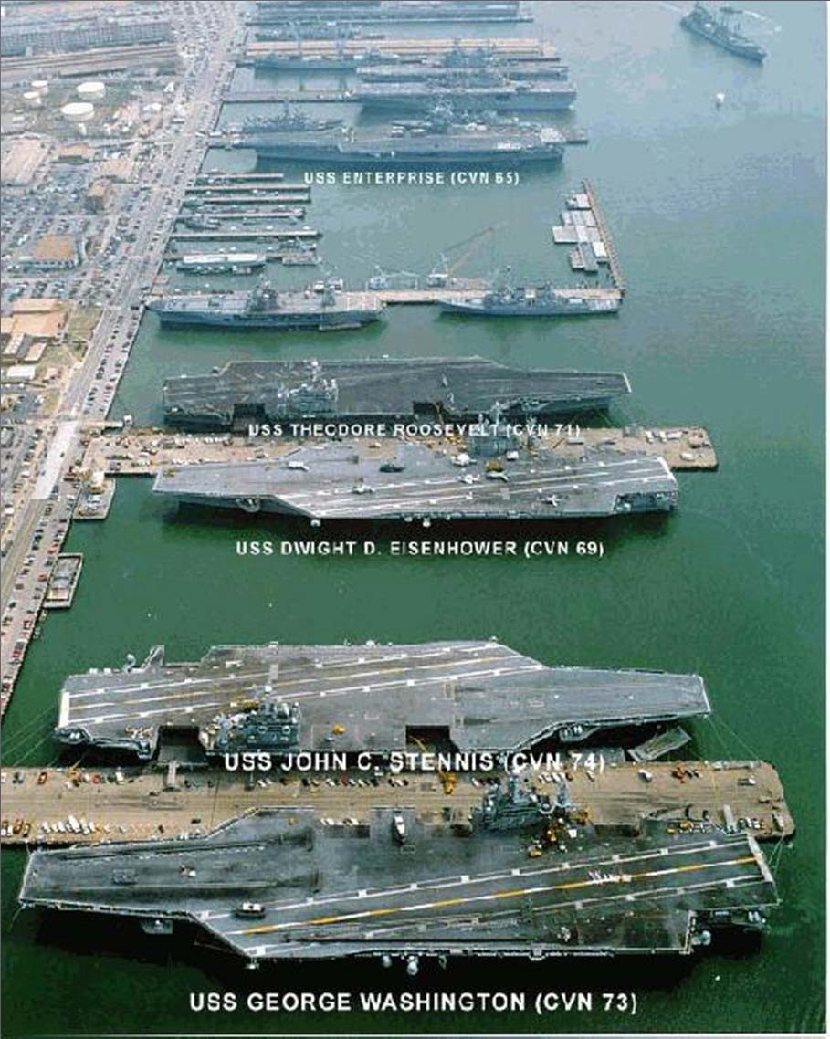
The heavy military expenditures throughout the Cold War benefited Virginia’s economy proportionately more than any other state.
Its impact was especially dramatic in Hampton Roads, home to several large naval and air bases.
Northern Virginia, home to the Pentagon and numerous private companies that contract with the military, was also impacted significantly.
Naval Station Norfolk

